Slide 1
We are Homes England

Slide 2
Community Led Housing
Peter Jones
Head of Affordable Housing - SW
31 July 2018

Slide 3
What will I be talking about today?
Homes England – who we are, what we do
Community Housing Fund Phase 1
Next steps

Slide 4
Background – who are we?
We were first referenced in Government’s Housing White Paper in February 2017
Chancellor Phillip Hammond included us as part of the November 2017 budget
We launched in January 2018 by the Secretary of State
It is more than just a name change!

Slide 5
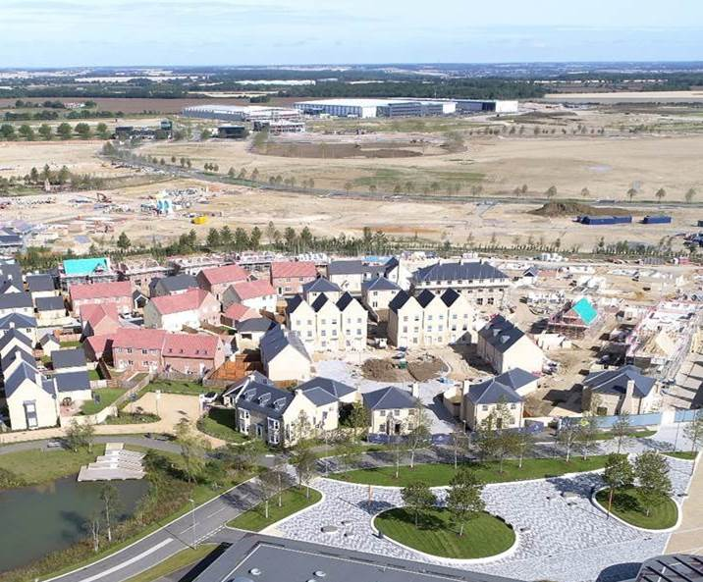
We have a big role to play
Our investment in supply and interventions in the market will help deliver 300,000 homes a year by the middle of the next decade.

Slide 6
We’re using our finance, land and expertise to get new homes built in ambitious places, demonstrating how government is prepared to intervene to unblock development and help people and businesses thrive.
Nick Walkley
Chief Executive

Slide 7
To meet our goals, things will have to change.

Slide 8
What’s different?
Speed
We will act differently
from our predecessor to
accelerate the supply of
new homes and address
affordability issues.
Resources
We will use our land,
finance and expertise to
expand the delivery of
affordable new homes
and connect ambitious
partners to remove
barriers to house building.
Quality
We will take the lead in
delivering better quality
homes and great places
that set the bar high for
others.

Slide 9
What’s different?
Bespoke approach
We will offer a bespoke
mix of direct capital grant
and financial transactions
to move supply.
Commercial
We will develop a new
commercial approach to
acquiring and developing
land in areas of high
demand.
Powers
If needed, we can also
use our planning and
compulsory purchase
powers to help willing
partners build more
homes more quickly.

Slide 10
We have three initial priorities
Continue delivery of our existing programmes
Build a new organisation capable of responding to the long-term housing challenges facing this country
Accelerate housing delivery over the next few years

Slide 11
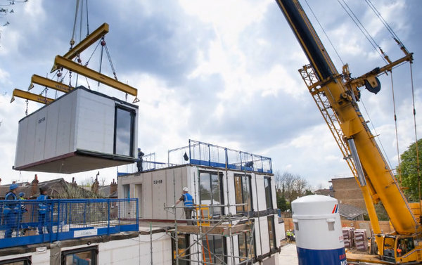
We want to disrupt the market
We need to increase the number
of people building homes,
particularly SMEs and companies
using Modern Methods of
Construction.

Slide 12
Supporting new approaches
Supporting MMC
We’re really positive
about MMC and will use
our land and finance to
help scale it up.
New technologies
We will support a
spectrum of MMC
technologies through our
activities to grow
confidence in the sector.
Flexibility
We will increase flexibility
on construction routes to
achieve additional supply.

Slide 13
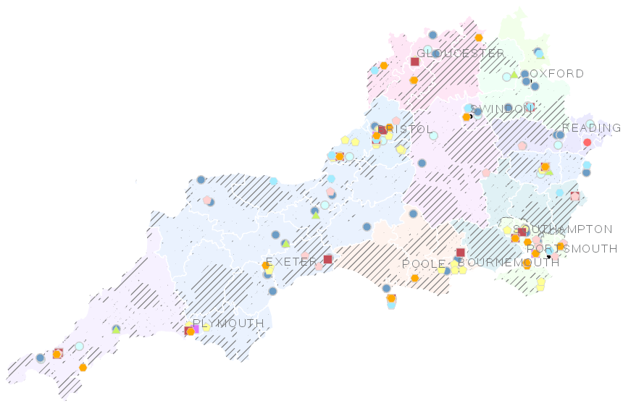
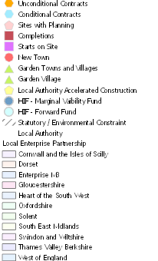
Introduction to the South West
Snapshot of current projects:
❑ Geographical area 32,080 sq. km
❑ Population 8.9m
❑ Rural Population 40% (England av. 24%)
❑ 3,993,620 homes

Slide 14
Team Structure
 |  | General Manager Kevin Bourner |  | OAGM Executive Assistant Ali Hooper Strategy and Information Manager Abigail Earle-Little
Home Ownership and Supply Peter Jones Ceri Loomes Versha Koria Lisa Clayton Stephanie Ainsworth Matthew Dodd Helen Brewer Andy Cowell Gareth Vickery Jonathan Edmondson Colin Case |  | Public Sector Land Catherine Turner Steph Braithwaite Helen Taylor Jonathan Turner Ian Collinson Kelly Hillman David Crook Tim Davis Adam Frontczak Peter Wynn Philip Evans Laura Kavanagh |  | Accelerated Delivery Ian Knight Jesica Ford Paul Britton Paul Flatt John Boutwood Bruce Voss Jeremy Herring Mark Glendenning Chris Dawson Sam Gammon Juliette Jackson Lucy Heath Lisa Broom Alastair McChesney
Supply of Affordable Homes Increase in tenure range Driving CME RP Relationships, Rural/Coastal Compliance Audit RCGF Estate Regeneration Community Led CA Board Relationships |  | Strategic Land Assembly Land Acquisition De-risking PS Sites HIF Supporting Strategic Growth Other Public Land and Assets Geographical Hubs of Activity Joint Land Board Relationships |  | 36k Strategic Land Disposal LAAC Off Site Construction DPP and developer relationships Commercial Disposals CA Board Relationships
Our team: Implement ambitious plans to create a more diverse and inclusive workforce with a more dynamic culture where people work together to deliver outstanding results |  | ONE AGENCY |  | Matrix Working: Collaboratively and in new ways across the Business between OA teams and Directorates
Notes:
OA structure, new text, future
Vic to send text
Skills
End slide

Slide 15
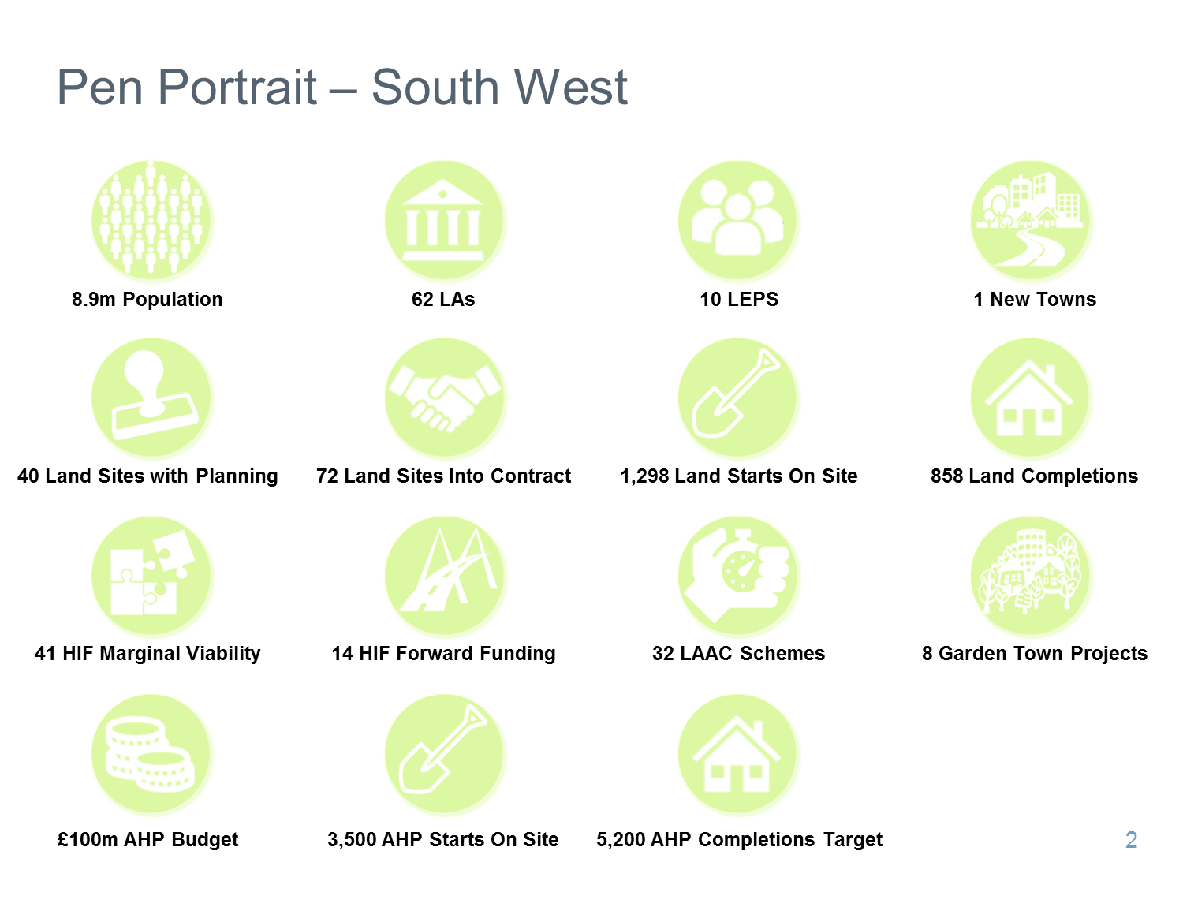

Slide 16
Headlines in the South West
Housing Deals
2 Housing Deals announced:
Oxfordshire
West of England (Bristol, BANES, South Gloucestershire and North Somerset)
Affordable Housing Deal
Progressing 1st wave
Affordable Housing Deal with
Sovereign/Liverty
£111.5m
2,275 additional affordable starts to March 2022
HIF Marginal Viability
South West MVF successful
bids:
c. 72K homes
c.£236m
.
HIF Forward Funding
South West FF successful
bids:
c. 140K homes
c.£1,473m
Land Acquistions
Active pipeline of future land
acquisitions currently being
pursued by Public Sector
Land and Accelerated
Delivery Teams
LAAC
Supporting and developing
LAAC offer to SW LAs (subject
to contract):
33 sites
c.5.5K homes
c. £70m funding

Slide 17
AHP targets 2018-19 £100m investment
3,500 starts
5,200 completions

Slide 18
Land targets 2018-19: 1,298 starts
858 completions
Achieve Planning on 38 sites

Slide 19
What does this mean for community led housing……
We have huge opportunities to use the additional funding and planning reforms outlined in the Budget to ensure that:
there is more land for housing,
there is further investment in infrastructure,
homes get built on the land as soon as possible,
new entrants are supported into the market, including SMEs,
brownfield sites are transformed,
we deliver the future Community Housing Fund (CHF), and
we support Government’s commitment to halve rough sleeping by 2022.
We need to explore new ways to deliver with ambitious new partners and clients – and community led housing is a big part of that.

Slide 20
Community Housing Fund phase 1 – objectives and key features
To increase housing supply in England by increasing the number of additional homes delivered by the community led sector
To provide housing that is affordable at local income levels and remains so in perpetuity,
To deliver a lasting legacy in the form of an effective and financially self-sustaining community-led body of expertise within the house building industry in England.
How can we work together to develop an investment pipeline?
Notes:
Networking – suppliers meet developers
SME focus - workshops

Slide 21
Community Housing Fund phase 1 – objectives and key features
 | Project related revenue | Infrastructure | LA capacity building
Who can bid? | Orgs that are, or intend to become, a body corporate | Local Authorities | Local Authorities
What will funding cover? | Group capacity building, project specific professional fees and costs, incl feasibility and design work, planning application, business and project planning | Associated capital infrastructure to open up sites for development, including access roads/roundabout, site remediation, flood attenuation, utilities | Capacity building activities and targeted support for community groups
Limits on payments? | No strict limit, but group must contribute 10%. To comply with de-minimus rule, total funding in 3 years to 2020 must not exceed 200,000 Euros | No strict limit, but not 100%. | No strict limit, but not 100%.
Time limits | All payment milestones reached by 31.3.20 | All payment milestones reached by 31.3.20 | All payment milestones reached by 31.3.20
Need to be RP? | no | no | no
How can we work together to develop an investment pipeline?
Notes:
Networking – suppliers meet developers
SME focus - workshops

Slide 22
How to bid?
www.gov.uk/government/collections/community-housing-fund
Notes:
To summarise that is….

Slide 23
Community Housing Fund – phase 2
Currently under development:
Looking at ways to fund costs of affordable housing development
New forms of affordable housing, including those not currently funded
How to combine with Affordable Homes Programme
Registration, Registration, Registration….
Notes:
Networking – suppliers meet developers
SME focus - workshops

Slide 24
Other support available
Affordable homes programme open for bidding - funding available for a range of tenures
Flexibility in 18/19 and beyond – using our land, collaboration and encouraging new entrants and new partnerships
Relationships, networks, brokerage and promotion
Land!
Investment via Home Building Fund
Key Message:
We want to promote community led development as an integral part of the development economy
We will use our networks, relationships and brokerage to support and promote the sector
By combining our funding, land and expertise we can support you

Slide 25
Thanks
Any questions?
Get in touch if you’d like to talk in more detail.
@HomesPJ
Peter.Jones@homesengland.gov.uk

