Slide 1

Right Care Right Person
Right Care Right Person (RCRP)
December 2024 Update

Slide 2
Right Care Right Person
Partnership Project – Sep 2023 to Feb 2025
Themes:
Understanding demand
The community impact
A collective objective
Right Care Right Person
Phase 1
Concern for Welfare. Control room triage live Jan 2024.
Phase 2
“Absconders” / MHA AWOL. Control room triage Jun 2024.
Phase 3
Phase 4
Transport of patients. Unable to achieve improvements at this time. Police data monitoring in support of any change or commissioning under NHS-NPA-RCRP guidance.
Section 136 and voluntary attendees. Officer guidance Jan 2025.
Notes:
MHA – Mental Health Act. MCA – Mental Capacity Act. PoS . RCEM – Royal College of Emergency Medicine.

Slide 3
Right Care Right Person
30 – 35 % CFW reduction seen by most forces.
Police time per incident, c 3.5 hours.
RCRP influenced MISPER incident change / reduction is masked by historical police use of CFW qualifiers.
Developing data per NHS trust & social care provider is challenging.
SWAST demand increased summer 2023, prior to but likely attributable to RCRP publicity.
NHS and social care data challenges disaggregating RCRP impact from data.
Police predominantly signpost to 111, 111 option 2, SWAST, Social Care and VCSE
Phase 1 and 2 – Toolkit Triage
Concern for Welfare (CFW) attended
January to November
2023 | 2024
28,377 | 18,401
CFW incident reduction 997, 35%
Missing Person (MISPER) attended
June to November
2023 | 2024
3,584 | 3,883
MISPER incident increase 299, % 8.3

Slide 4
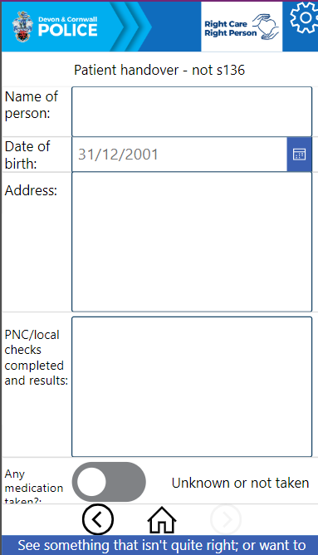
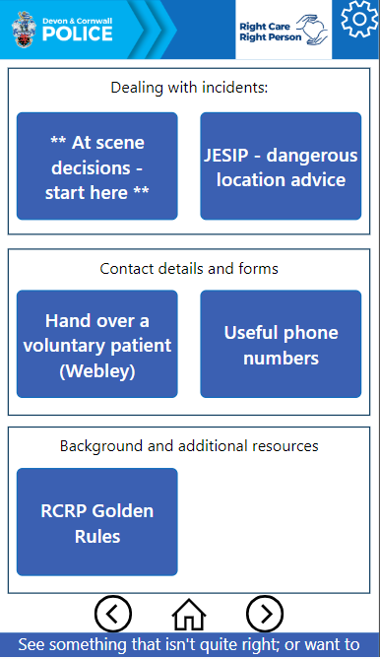
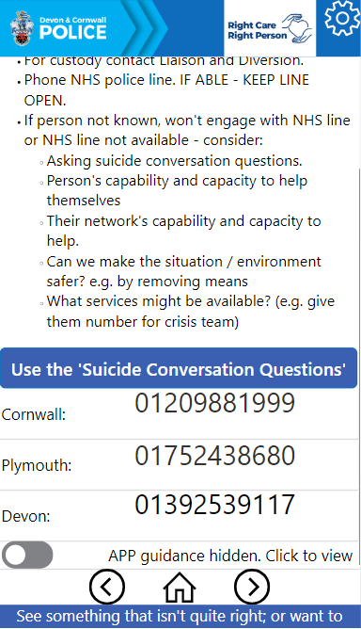
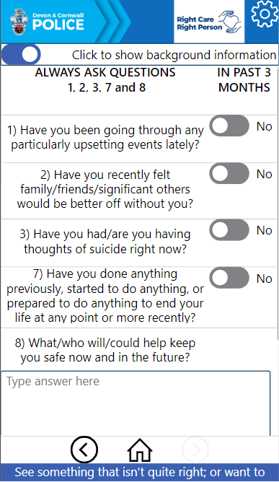
Right Care Right Person
Phase 3 – Officer Companion App for RCRP-Yes
Officers’ mobile
Device app.
Consultation and least restricted approach ethos.
Significant inclusions: Support for police conversations about suicide. Voluntary patient handover form.

Slide 5
Right Care Right Person
RCRP lessons so far!
  Use of plain language.
  Is it an “emergency” or “urgent”.
  Always best interests of a child – police car / uniform officer for PPP v urgent multi agency or single service visit.
  Who can legally force entry?
  People collapsed at home is the biggest challenge.
  Public awareness of 111, 111 option 2.
  Police can signpost but not refer people to health options.
  Common signposting – SWAST, 999, 111, 111 option 2, GP, social care, MASH/MARU if a child..
  Police can’t “strong arm” someone into hospital for treatment.
  Police can only detain people to have a mental health act assessment.

Slide 6
Devon and Cornwall Isles of Scilly Right Care Right Person Systemic and Escalation Structure
Annex A to
RCRP Escalation paper
15 Jan 24
RCRP Strategic Partnership Group
ACC Mayhew (DCP)
RCRP Tactical Partnership Group
C/Supt Sheon Sturland (DCP)
Cornwall Isles of Scilly (CIOS) Crisis Care Concordat (CCC)
Tim Francis (CIOS ICB)
Devon Police Liaison Group
Penny Rogers (Devon ICB), Supt Butler-Jones (DCP)
CIOS Operational Delivery Group
Mark Bolt (CFT)
(Insp Dee Evans (DCP))
Learning From Experience Quarterly
Mark Bolt (CFT)
Insp Dee Evans
Multi Agency Suicide Prevention Group
Paula Chappell (CCC)
(Sarah Daniles-Day (DCP))
Plymouth Police Strategic Group
Eva Jakobsen (Livewell)
(Insp Sarah Ronayne)
Mental Health Liaison Group (Southern Locality)
Health Led – Sarah Venning DPT
Insp Ian Stevens
Exeter, East and Mid Devon Mental Health, Police & Social Care Group
Health Led – Matt Phillips DPT
Insp Grant Leitch
Mental Health Liaison Group (Northern Locality)
Rotating Chair
Police Led - Insp Andy Wills
U18 Place of Safety Meeting
Anita Dykes (Plymbridge)
Julia Moore (DCP)
Inter-Agency Problem Solving (Plymouth)
Eva Jakobsen
Insp Sarah Ronayne
Devon Suicide Prevention Oversight Group
Nicola Glassbrook (PCC)
Sarah Daniels-Day
Adult & Children Safeguarding Groups
TBC
“Safer Cornwall” Adult and Children Safeguarding Groups
TBC
Community Safety Partnerships, Collaboration Partnership Groups and voluntary, community, third sector and lived experience groups.

