Slide 1
Research in Devon – local perspectives
Notes:
These slides are for NIHR CRN staff to use when presenting at meetings and events. They are not intended to be used as a whole presentation (although they could be), but are for staff to pick from, so they can tailor their presentation to their audience. These general slides should be used alongside slides that have been produced specifically for meetings and events. There are empty slide templates at the bottom of the slide deck.
These slides were updated in October 2021.
If you have any queries, please contact crncc.comms@nihr.ac.uk.

Slide 2
What do we mean when we talk about research?
Research is a broad term – we’re referring mainly to research relating to health and social care.
Research can take many different forms – it can be scientists working in a lab, it can be care home staff finding better ways to provide care, and anything around/in-between.
At its core, research is taking a question, designing methods to investigate that, and then analysing the results to produce findings/an answer.
Any question can be answered through research! And it’s important that we’re doing research that is important to our local communities.
Notes:
Jess to present
To give a bit of background so that we’re all clear what we’re talking about with regards to ‘research’ – and that the NIHR related to health and social care.

Slide 3
NIHR – our mission
We do this by:
Funding high quality, timely research that benefits the NHS, public health and social care
Investing in world-class expertise, facilities and a skilled delivery workforce to translate discoveries into improved treatments and services
Partnering with patients, service users, carers and communities improving the relevance, quality and impact of our research
Attracting, training and supporting the best researchers to tackle complex health and social care challenges
Collaborating with other public funders, charities and industry to shape a cohesive and globally competitive research system
Funding applied global health research and training to meet the needs of the poorest people in low- and middle-income countries
To improve the health and wealth of the nation through research

Slide 4
NIHR CRN – our vision
Our vision
Clinical research is an integral part of healthcare for all
Our purpose
To make people and the NHS better by enabling and
embedding high quality health and social care research as an
integral part of care
Notes:
This slide outlines the Clinical Research Network's vision and purpose.
We believe that research should be integrated into everyone’s care plan as a core part of healthcare delivery, not as an add-on or afterthought.
Our purpose is to improve care, advance treatment and enhance the NHS service by embedding high quality research into every healthcare plan.
Jess can then talk about the Biomedical Research Centre – slightly different type of research. Feeds into next slide looking at different NIHR infrastructure/centres, and that they all look at different types of research in different areas, but we all work to the NIHR mission.

Slide 5
Devon Research Infrastructure - NIHR
Biomedical Research Centre
Health Tech Research Centre
Clinical Research Facility
Applied Research Collaboration
Dementia and Neurodegeneration Policy Research Unit
Clinical Research Network / Research Delivery Network
Health Determinants Research Collaboration
NIHR Schools – primary care/ public health
University of Exeter/ University of Plymouth/ Marjon

Slide 6
Why we need to engage and work with the public/patients and broaden participation and involvement?
Involving people in research about their health and lives is increasingly seen as both morally correct, and strengthens the quality of findings; maximising the contribution of research to society (Health Research Authority 2023; DHSC 2023).
Participation in research may provide early access to cutting-edge treatments or help to improve outcomes more widely, while patient and public involvement can improve the design and delivery of research itself
The Future of UK Clinical Research Delivery report (DHSC 2021), “making research more diverse is critical to addressing persistent health inequalities.” There is recognition that some people and groups more than others are ‘under-served’ by research, …..the research community needs to provide a better service to these groups, rather than the lack of inclusion being due to any fault of the members of these groups (NIHR, 2020
Notes:
Jess to present

Slide 7
Strategic Commitments for Public Partnership
Between 2025 and 2030, NIHR will:
Embed research inclusion Make sustained progress in widening research participation, embedding research inclusion and increasing the diversity of the public and communities who participate in, shape and deliver research.
Strengthen partnerships Strengthen and grow mutually beneficial partnerships between researchers and communities, and their community-based organisations, to better reflect the diversity of the population.
Improve reward and recognition Make systems of reward and recognition for the involvement of people and communities more equitable, efficient and consistent across NIHR coordinating centres, infrastructure and research.
Require feedback In response to consistent demands from patients and the public, require those who commission, undertake and support research to provide feedback to the public and communities on their contributions.
Strengthen capability and capacity Improve access to evidence, materials, training and peer support so that research teams can conduct effective and meaningful public partnerships.

Slide 8
Research opportunities
Research across the health and care system
Royal Devon University Healthcare NHS Foundation Trust
University Hospitals Plymouth NHS Trust
Devon Partnership Trust
Livewell South West
GPs across the county
Schools
Hospices
Care Homes
Non NHS sites

Slide 9
Covering 30 Specialties
Stroke
Diabetes
Each LCRN delivers research across 30 specialties:
Ageing Anaesthesia, perioperative medicine and pain management Cancer Cardiovascular disease Children Critical care Dementias and neurodegeneration Dermatology Diabetes Ear, nose and throat Gastroenterology Genetics Haematology Health services and delivery research Hepatology
Infectious diseases and microbiology Mental health Metabolic and endocrine disorders Musculoskeletal disorders Neurological disorders Ophthalmology Oral and dental health Primary care Public health Renal disorders Reproductive health and childbirth Respiratory disorders
Stroke Surgery
Trauma and emergency care
Cardiovascular disease
30
Clinical Research Specialties
Mental health
Notes:
This slide outlines the 30 specialties that the NIHR CRN covers.
The NIHR has widened its focus to include social care research that aims to improve the quality of life for users and carers through better social care provision and practice.
The 30 specialties are managed by are managed via six Specialty Cluster Leads and Assistant Specialty Cluster Leads.
The NIHR Clinical Research Network (CRN) has convened the NIHR Covid-19 Understanding and Elimination-Trials Implementation Panel (CUE-TIP) Group to provide cross-specialty oversight for the delivery of studies relating to COVID-19. The group provides strategic clinical oversight across the entire COVID-19 Portfolio..

Slide 10
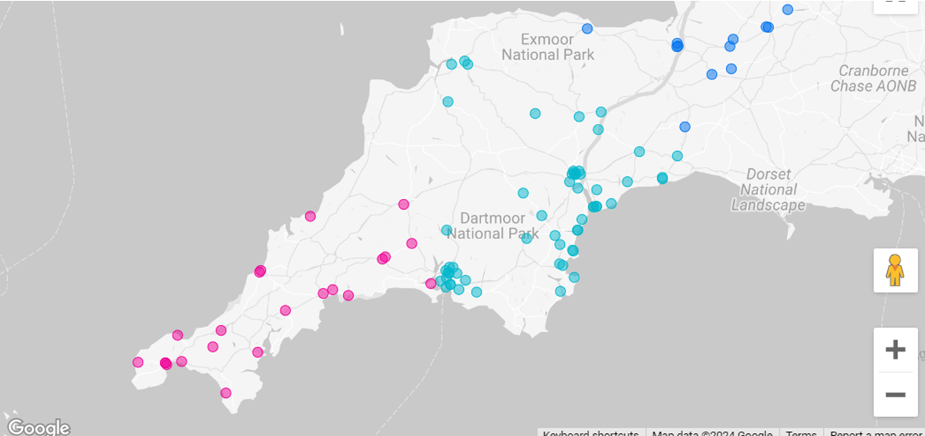
Research Active GPs

Slide 11
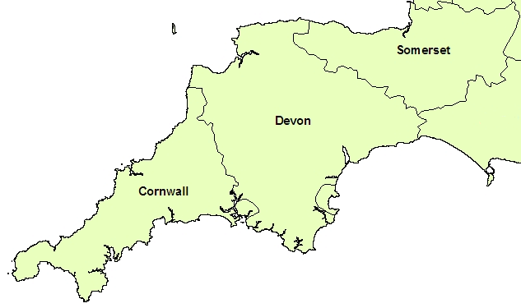
Agile workforce - Geographical spread – improving access to research

Slide 12
Collaboration - VCSE
Refugee study in Plymouth; Family Parent Carer research (Exeter); Nature on prescription
Pay Service support costs to organisations that support the identification of participants
Need to co-design VCSE partners into research proposals at the grant submission stage to provide active roles; champions to provide support with digital access;
Opportunities to promote research
Be Part of Research Campaign
Notes:
Share these examples of ways that researchers are collaborating with VCSEs, and other ways that VCSEs can support people getting involved.

Slide 13
What are you already involved in? What would you like to see?
We’d love to hear about the types of research projects that you and partners are involved in – and with which other organisations.
What sort of projects and types of research have you been involved with?
What sort of projects or areas of research would you like to get involved with?
What would you need to work with us, and how might we support that?
Notes:
Jess to present
Final slide – leaving people with an ask. Either to share there, or to take away and come back with (will provide contact info).

Slide 14
Thank you!
Please do share ideas for ways we can support each other:
involvement@exeter.ac.uk

