Slide 1
Food Plymouth and Sustainable Food Places
by Ian Smith – Food Plymouth Core Enabling Team and CIC
December 2024

Slide 2
Context
2010 - Food Plymouth formed – a pioneering member of the National Sustainable Food Cities / Places movement (working towards change for the better throughout food systems)
A cross-sector Partnership and Network – working to a Collective Impact model - with Devolved and Dispersed Leadership (leadership at every level) - and a social enterprise infrastructure organisation
2015 - Plymouth Sustainable Food Cities BRONZE award
2018-19 - Tipping Point - Thrive Plymouth Year 5 - ‘People connecting through food’ (closer collaboration and more joint working with Plymouth City Council Public Health)
2020 onwards - Food Plymouth a partner in the £6.2M UKRI TUKFS FoodSEqual project

Slide 3
Working
Strong relationships and effective joint working when the COVID-19 pandemic struck and the subsequent Cost of Living Crisis took hold
=> Plymouth VCSE Planning and Response group
Collaborative working across the geographical / ceremonial county of Devon => Devon VCSE Assembly Food Insecurity Working Group => Devon Food Partnership
Community Resilience – through the lens of ‘People connecting through food’ – including Race, Equity, Diversity and Inclusion (REDI)
Sustainable Food Places SILVER award achieved 2023
Local working within a national movement – one of 114 sustainable food places

Slide 4
Collaborative delivery on Plymouth’s Three-Pronged Approach to Food Security:
Alliance – Food Aid to Food Access
Collective (‘The Bridge’)
Connections

Slide 5
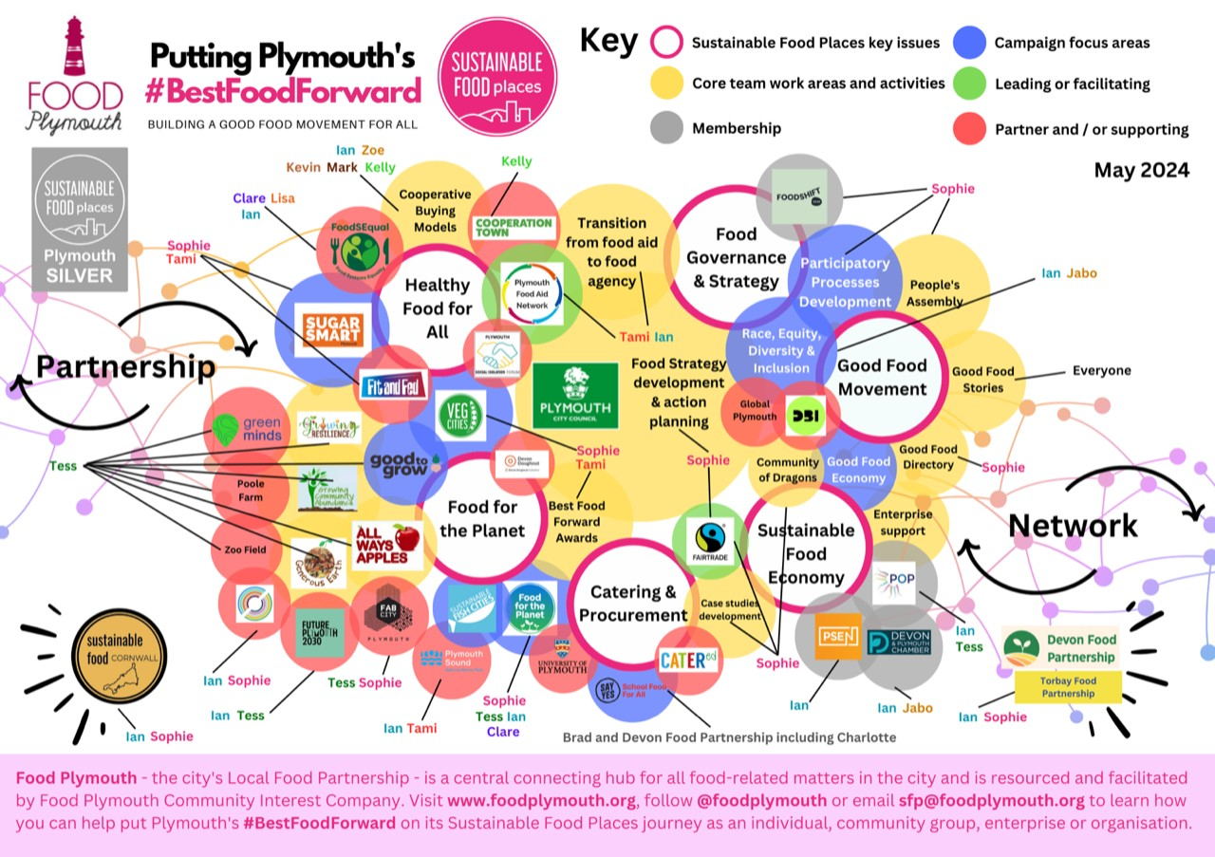

Slide 6
Next
Accelerating Pioneering and Connectivity - Great South West Orientation
Leading Partners in Community Resilience / REDI / Plymouth VCSE Planning and Response / Devon VCSE Assembly
Progression from Sustainable Food Places SILVER to GOLD
Agility / Resourcefulness / Value-for-Money – well-placed re Austerity 2.0
Co-operatives
Risk Management
- Passengers / Parasites / Predators
- Institutional Cynicism towards VCSE (third sector naivete an issue too)
Research and Innovation (ideally on a broad base)
Consultancy, Coaching and Mentoring
Accent on Independence and Enterprise

Slide 7
www.foodplymouth.org
www.sustainablefoodplaces.org
Ian Smith (Food Plymouth Core Enabling Team and CIC)
e-mail ianmsmith1.5@gmail.com
mobile 07720174634

