Slide 1
Community Empowerment Programme
‘working collectively with communities to deliver the city we want’
Leadership and Cultural Change:
Council wide approach to working with communities
Taking a systems approach to tackling health inequalities
Asset Based Community Development – training and community of practice
Appreciative Enquiry as a model of understanding to influence decision making
Volunteering:
Promote understanding, awareness and opportunities
Support inclusion and diversity
Coordinate citywide network to share best practice/learning/collaboration
Creating conditions for external organisations to support greater prosperity
VCSE Network
Inclusive Growth Network
Community Asset Transfers
Wellbeing Hub Network
Enabling Community Resilience
Community Builders
Income maximisation
Food Security
Nature connection and Climate Change

Slide 2
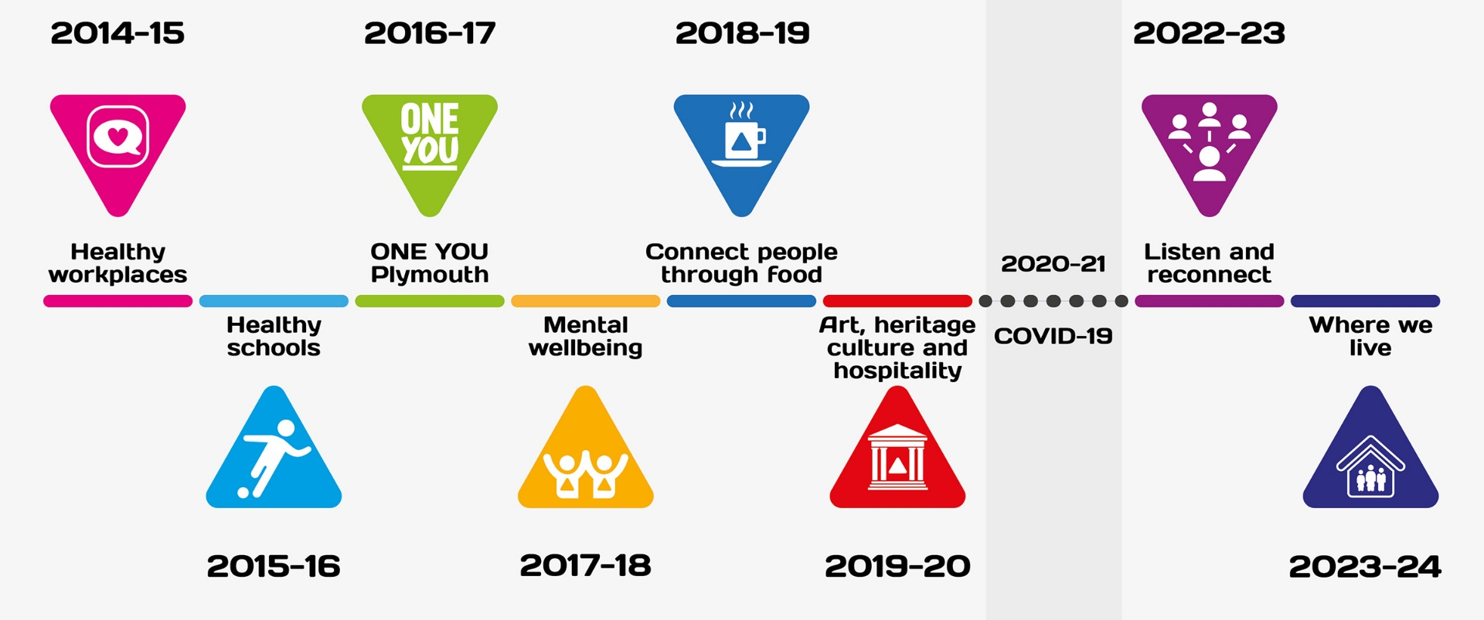
Thrive
10 years of partnership working to create a social movement to reducing health inequalities
300 people attend from over 100 organisations
Plymouth City Council’s engagement has evolved to be supportive and enabling, rather than as an operational lead

Slide 3
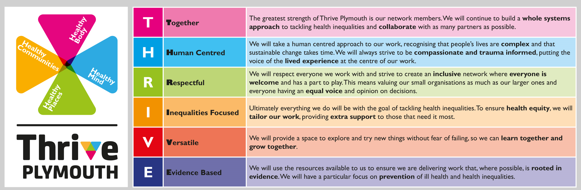
Thrive 2024 - 2034
The programme was refreshed and relaunched for another 10 years in November 2024, with a new construct and new principles.

Slide 4

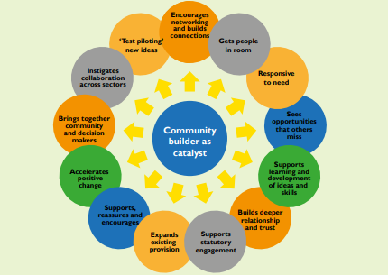
Community Builders
Community Building
Employed by Four Greens Community Trust
13 Community Builders
1700 listening conversations
791 residents leading
255 new community-based activities
90 ABCD trained practitioners
“The Community Builders serve as a bridge between the community and organisations, enabling residents to connect with resources effectively.” Independent Evaluation

Slide 5
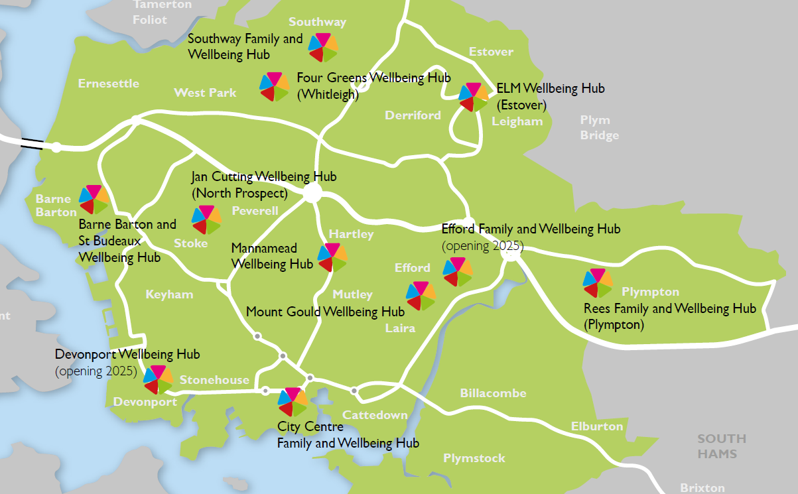
Wellbeing Hub Network
VSCE led
9 sites
142 services weekly
5000 people weekly
‘no wrong door’
Place-based &
Specialisms
CORE20: Addressing health inequalities in the most deprived 20%
PLUS for people outside of deprivation scope but still experience health inequalities
Responding to 5 NHS clinical areas of focus
Primary and Secondary Care; Housing health and social care; Economic and Community
Notes:
Meet medical as well as social needs.
Keeping people well close to where they live; managing long term conditions; providing spaces to connect, engage, create

Slide 6
VCSE Network
Evolved from a response to Covid
Membership of around 80 – VCSE, Health, Housing, PCC, Grassroots
Fortnightly initially, moved to monthly in 2023
Chaired by PCC but agenda led by members
Builds relationships and communication
Strategic issues related to VCSE and Local Authority; sharing updates and citywide events; Links to wider region / county
Meeting themes have included:
Consultation for the Civil Society Covenant
Local Care Partnership / Devon ICB – Service Delivery Model
Guest speakers on particular topics: VAWG; Marjon Youth and Community Work offer; Human Learning Systems; Libraries offer; Marie Curie Life Cafes

