Slide 1
Emergencies Partnership:
An introduction
Stronger Together

Slide 2
What is the VCSEP?
The Voluntary and Community Sector Emergencies Partnership is a partnership between national and local voluntary and community sector organisations. The Voluntary and Community Sector Emergencies Partnership (Emergencies Partnership) recognises the crucial role of the voluntary sector, at grassroots and national level, in supporting those in need. But we also see the increasing demands made on the sector.
We are here as a safety net
to boost and enhance the support the sector can give,
to further strengthen coordination of national and local response efforts during emergencies and
to provide a single access point between government and the voluntary and community sector
Right now we are responding to the evolving Covid-19 crisis, but our long-term ambition is to establish a legacy which enables the voluntary and community sector, government and statutory agencies to work better together to ensure our country’s most vulnerable communities get the right support at the right time in an emergency.

Slide 3
VCSEP make up
And more….

Slide 4
What we’re aiming for…
…and how we plan to do it
1
Improved and ongoing insight and understanding of changing and unmet needs.
2
Improved multi-agency coordination and brokerage of sector-wide resources to take action to meet those needs
3
Improved and sustained collaboration and support for grass roots level activity with regional and national VCS and government
Notes:
The VCSEP designed a model with the intent of
Improving ongoing understanding of unmet need
Improving coordination of the sector’s intelligence and resources to take action to meet that need
Improving sector support for local grassroots level activity from regional and national organisations
The VCSEP is designed around four key areas:
Gather and build understanding through convening and bringing together intelligence and experience from a range of sources – crucially, from grass roots teams, gathering local insight and requests for needs/support
Inform, using data analysis of that local insight combined with monitoring the national picture to report on what that tells us
Respond and coordinate our activity as a sector, routing unmet need requests to where there is sector resource to help
Influence by building a heightened level of awareness and understanding of what the needs are and where across the sector, and crucially at government level
Our main products are:
Unmet need platform
Request for support service and multi-agency cells
NCC

Slide 5
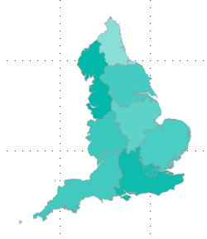
Brokering Unmet Need: VCSEP Multi-agency Cells
The Emergencies Partnership has established five regional multi-agency cells across England to help local organisations to continue their work in the community.
Aim: To bring multiple regional VCS players together in a crisis to understand need that is going unmet, and provide sector-support to local organisations when and where they need it.
North
Midlands and East
VCSEP strategic coordination group
London
South East
South West

Slide 6
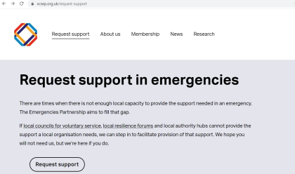
Request for support made
Local Liaison lead reviews request and checks it can’t be fulfilled locally
Request is escalated to VCSEP multi-agency cell if it can’t be met locally
Large-scale national requests escalated to VCSEP Strategic coordination group
Getting support from the VCSEP
www.vcsep.org.uk
The request for support service provides a simple way for local organisations to request additional support and capacity to meet the needs in their area, when they cannot be met locally.
You can submit your request for support at vcsep.org.uk/request-support.

Slide 7
What this is not
A proposal that seeks to duplicate anything by
replacing the hard work and response already underway – where needs are being identified and met locally
undermining the relationships already held locally to achieve an effective response
changing any links to LRF partners, local authorities and wider central and local government structures in response activity
What this is
a by exception option, quick escalation point for organisations to report unmet need/need for support where it can’t be addressed through usual routes
a way to then facilitate the right organisation(s) with the capacity or the right skills to help meet the unmet need, accelerating help
overall, a way for us to take informed and effective action together

Slide 8
Get in touch
National Emergencies Partnership team:
VCSEP@redcross.org.uk
Multi-agency cell leads:
London - Jon Vangorph, JVangorph@redcross.org.uk
Midlands & East – Simon Holmes, SHolmes@redcross.org.uk
North - John Morris, JMorris@redcross.org.uk
South East - Donna Taylor, DTaylor@redcross.org.uk
South West - Helen Sithorp, HSipthorp@redcross.org.uk
Stakeholder Engagement Managers:
London – Ali Malvern, ali.malvern@re-act.org.uk
Midlands & East – Jon Everett, jon.everett@re-act.org.uk
North – Mark Bellamy, mark.bellamy@re-act.org.uk
South East - Steve Findlay, steve.findlay@re-act.org.uk
South West - Becky Maynard, becky.maynard@re-act.org.uk
Sign up to the fortnightly newsletter by emailing:
VCSEP@redcross.org.uk

