Slide 1
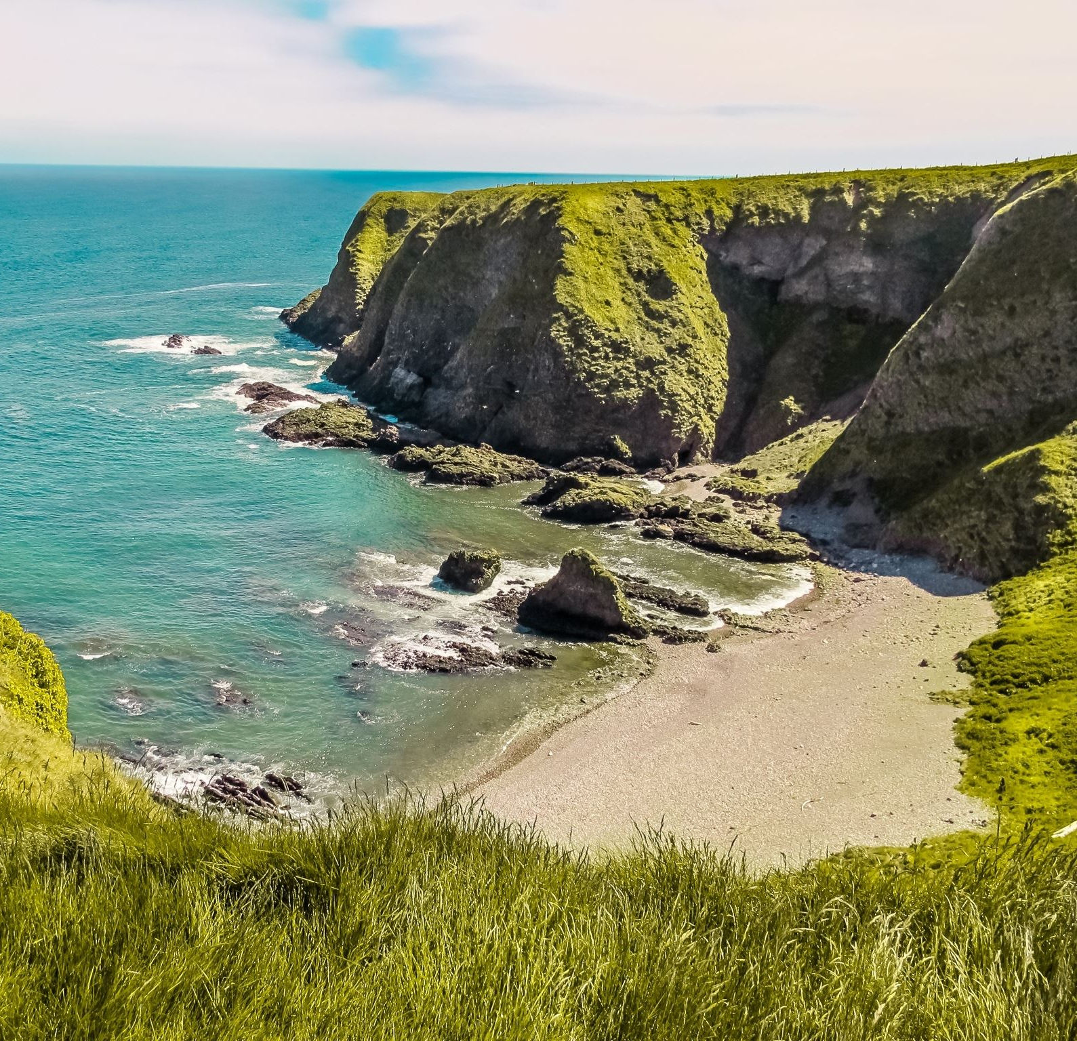
Building a Strong and Vibrant VCSE sector
NATIONAL LOTTERY PROJECT
Taw and Torridge Voluntary Services
and
North Devon Voluntary Services

Slide 2
Overarching Aim & Background
The Project’s Overarching Aim is as follows and aligns to that our both CVS’
To build and sustain a strong and vibrant VCSE sector, using a community development alliance model, to bring about social change and improve the quality of life across North Devon and Torridge.
An alliance model that is not only sustainable but enables social mobilisation amongst all sectors of our communities (including those hidden/quiet voices), resulting in proud, thriving, healthy, self-reliant, solution focused, cohesive and collaborative resourceful northern Devon communities for generations to come.
Building and enhancing the work of the ‘one communities’ model
Which then can also provide a national framework of community development best practice

Slide 3
Effective & sustainable community development = we all benefit!

Slide 4
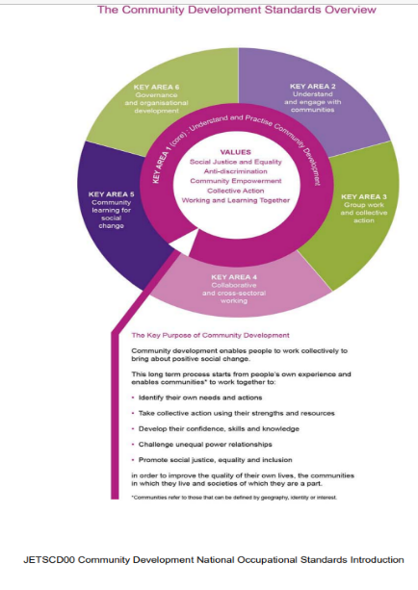
NORTH DEVON COMMUNITY ALLIANCE
To build an inclusive and integrated community development framework across Northern Devon.
To build this framework and accurately reflect our outcomes, we need to ensure we are following the Key Areas and Standards for Community Development Practice (Summary Community Development National Occupational Standards (cldstandardscouncil.org.uk)

Slide 5
Underpinned by Key Values
Social justice and equality
Anti-discrimination
Community empowerment
Collective action
Working and learning together

Slide 6
1a. Learning what best practice looks like in relation to mobilising social action. | 1b. Understanding effective ways of working to engage with, and then support, local communities, in particular disadvantaged groups. | 1c. Improved Partnership working.
OVERALL PROJECT OUTCOMES

Slide 7
2a. Continue to make a positive impact within the community, by allowing current groups/networks to connect, flourish and grow.
2b. Recognition of what the positive impact that VCSE organisations can have, alongside, savings around preventions. This includes the Council for Voluntary Services, as the infrastructure, who are the lynch pin and connectors.
2c. Bring about positive social change and mobilising social community action through effective engagement with communities. To support them and to identify and implement solutions which improve people lives.
CVS OUTCOMES

Slide 8
PROJECT STAFF OUTCOMES
3a. A supported and recognised community development workforce
3b. Understand and Practice community development, aligned to national occupational standards and values.

Slide 9
PROJECT OUTCOMES FOR INDIVIDUAL CITIZENS
Forward three years to strong, thriving, healthy, self-reliant solution focused resourceful communities with a legacy through this funding.
A strong and empowered community who feels heard, understood, part of the decision-making process and with a strengthened confidence, set of skills and knowledge.

Slide 10
But….
We require match – funding
£50k a year at least
CVS’ stripped their budget allocation, to secure this work – get over the line.
Lottery very clear from start – cannot be the only funders
One Northern Devon continued to match fund
Enough to run for 2.6 years rather than 3 years
Moving over to alliance model – as proved its worth and impact
Reducing hours as community mobilising
Model does not work and seek alternative methods and funding

Slide 11
MATCH FUNDING IDEAS?
If you have a community problem that needs solving – you can procure specific community development time
FOR JUST @ £22.00 PER HOUR
OR
If your organisation can see the benefits of investing in this, in the longer term
Please do get in touch to discuss in more detail
OR for one-time donations please DONATE via our Crowdfunder link
https://www.crowdfunder.co.uk/p/building-a-strong-vibrant-vcse-sector---n-devon

Slide 12
CHALLENGES?
Apart from match funding………………..
FEAR of change?
Group think and Personalities?
How can we compare – One Communities?
Challenging the Status Quo?
How to engage effectively community – esp those hidden voices?
Right levels of consultation and at right times?
Mapping against standards?
Lack of support for an alliance?
Getting the right evaluator?

Slide 13
THE ASK OF THE ASSEMBLY?
Would you like to know more?
Can you collaborate?
Can you assist with our match-funding?
Have you any consultations/research/best practice, willing to share?
Do you want to be kept informed?
Can we help you?

Slide 14
Help us be the forerunners in producing a community development alliance framework, with a sustainable legacy, supporting our communities to thrive and grow

Slide 15
ANY FURTHER QUESTIONS
Marie Gould – Chief Officer – North Devon Voluntary Services
Beki Sharples – Chief Officer – Taw and Torridge Voluntary Services
Beki@ttvs.org.uk
Chief.officer@ndvs.org.uk

