Slide 1
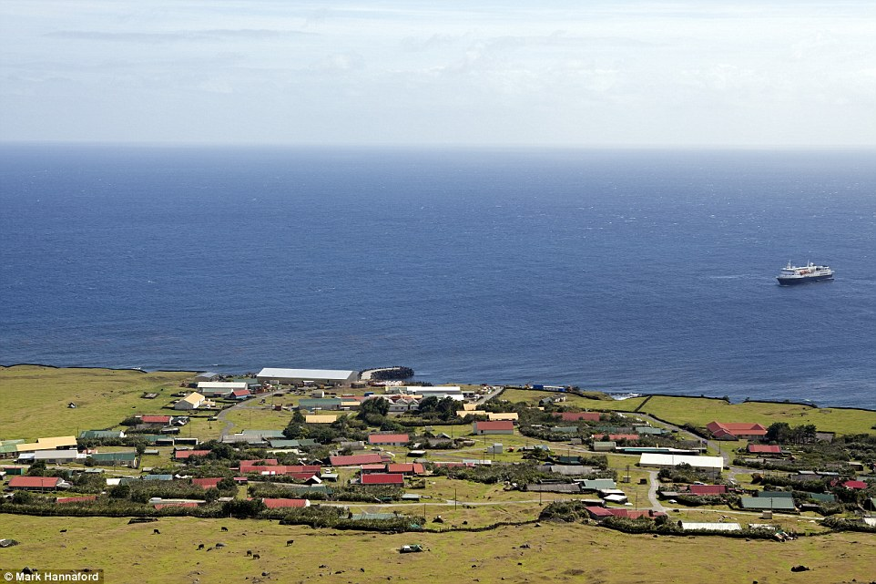
1,491 Miles from the nearest continent and home to just 300 people in one Village at the foot of an active Volcano! Tristan da Cunha is the World’s most remote Island.

Slide 2
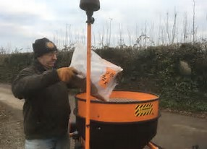
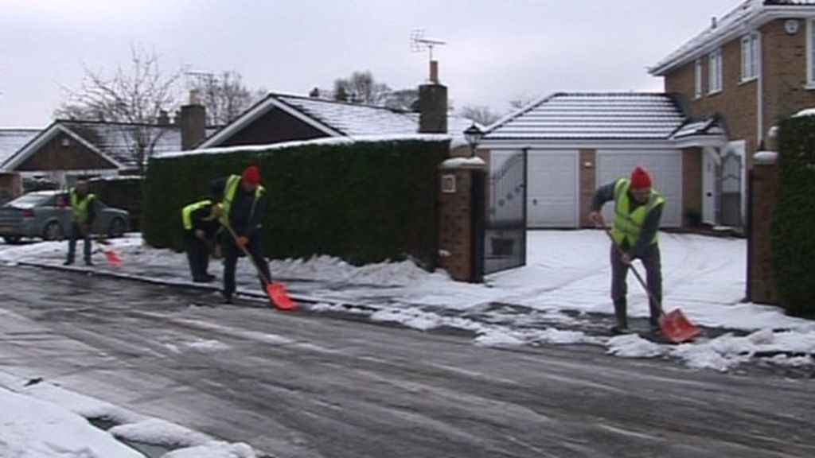
Snow Wardens

Slide 3
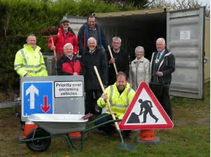
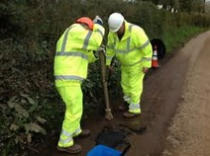
Road Wardens

Slide 6
Community Strategy

Slide 7
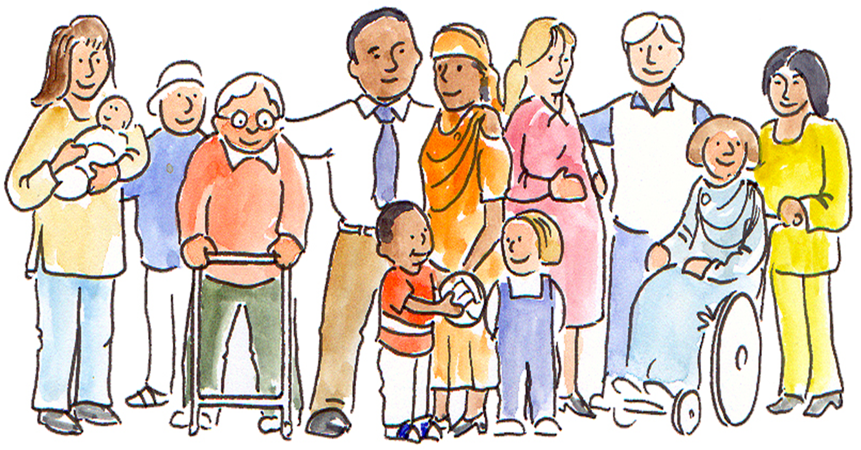
Community Strategy
Our vision for Devon’s communities to have “Flourishing people and communities that are strong, kind,
compassionate and safe.”

