Slide 1
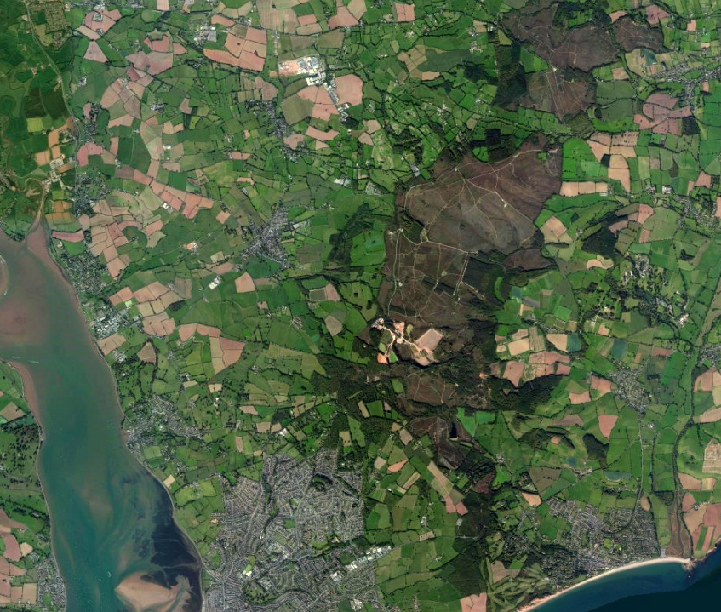
Woodbury Salterton
Resilience Group
Spring Line
Woodbury Salterton
Woodbury Common
Woodbury
Exton
Exe Estuary
Exmouth
Why did we need a Resilience Group?

Slide 2
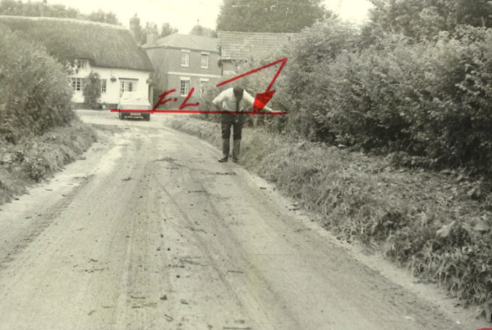
Woodbury Salterton
Resilience Group
Flooding History
Flood level reached in 1972
Taken from the
Rivers Authority
Records from
The 1972 Floods
Honey Lane

Slide 3
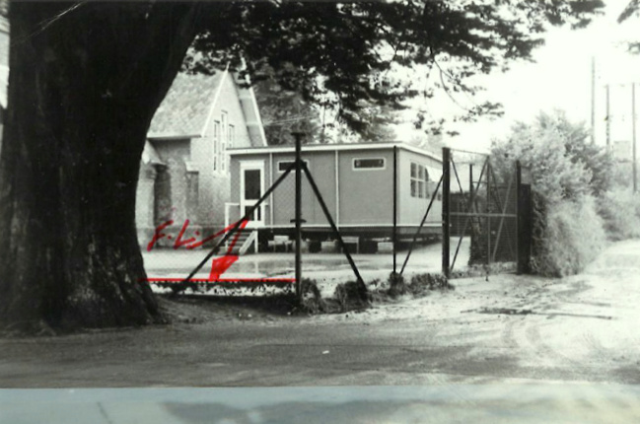
Woodbury Salterton
Resilience Group
Flooding History
Primary School
In the middle
of the village
Taken from the
Rivers Authority
records from
the 1972 Floods
Flood level 1972

Slide 4
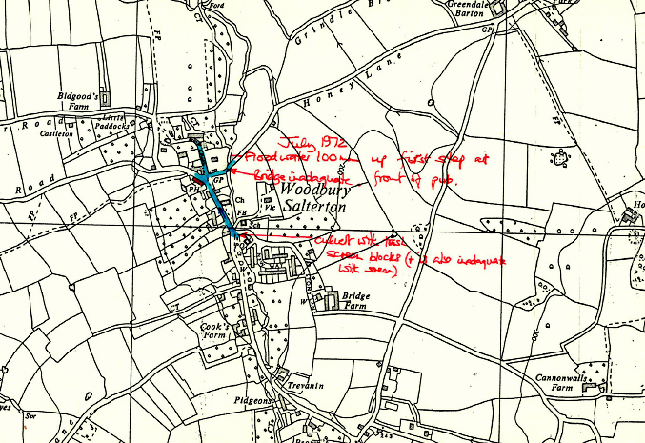
Woodbury Salterton
Resilience Group
Flooding History
Bridge inadequate
This was improved
with extra culvert
Taken from the
Rivers Authority
records from
the 1972 Floods
Culvert with trash screen blocks (+ is also inadequate) The Screen removed but the culvert still the same as 1972

Slide 5
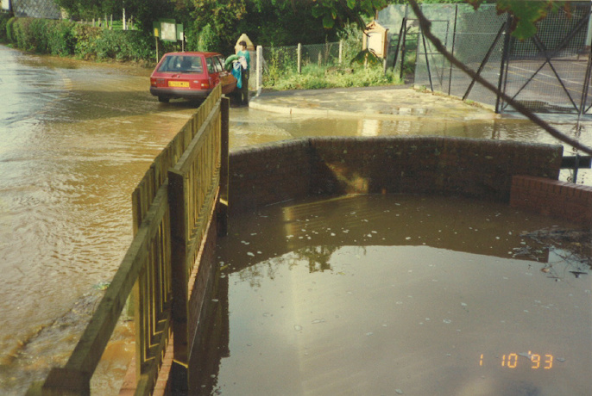
Woodbury Salterton
Resilience Group
Flooding History
Taken from the
Rivers Authority
records from
the 1993 Floods
Culvert blocked
The wood fencing was removed following
these floods

Slide 6
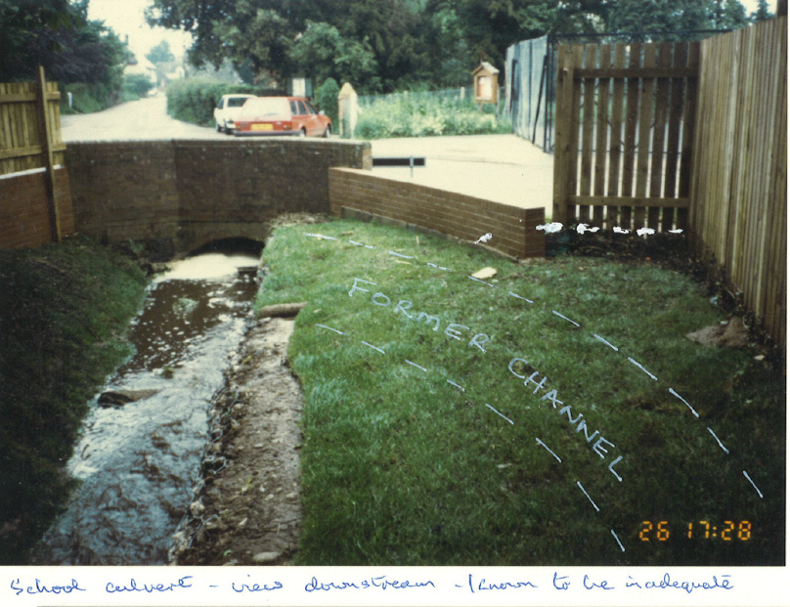
Woodbury Salterton
Resilience Group
Flooding History
This fence
has now been
replaced
with a brick wall
to protect the
property
Taken from the
Rivers Authority
records from
the 1993 Floods
School Culvert view downstream

Slide 7
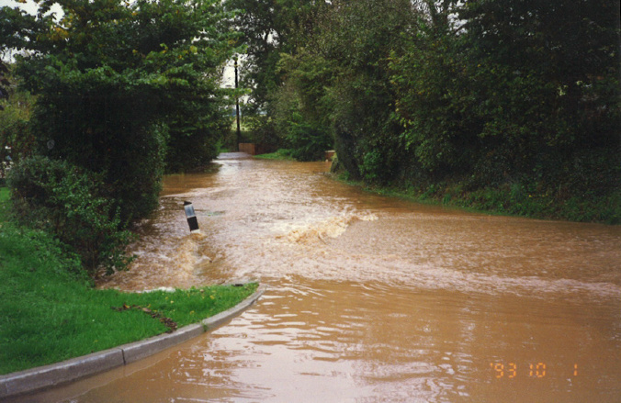
Woodbury Salterton
Resilience Group
Flooding History
Bridge and stream
Honey Lane
Taken from the
Rivers Authority
records from
the 1993 Floods

Slide 8
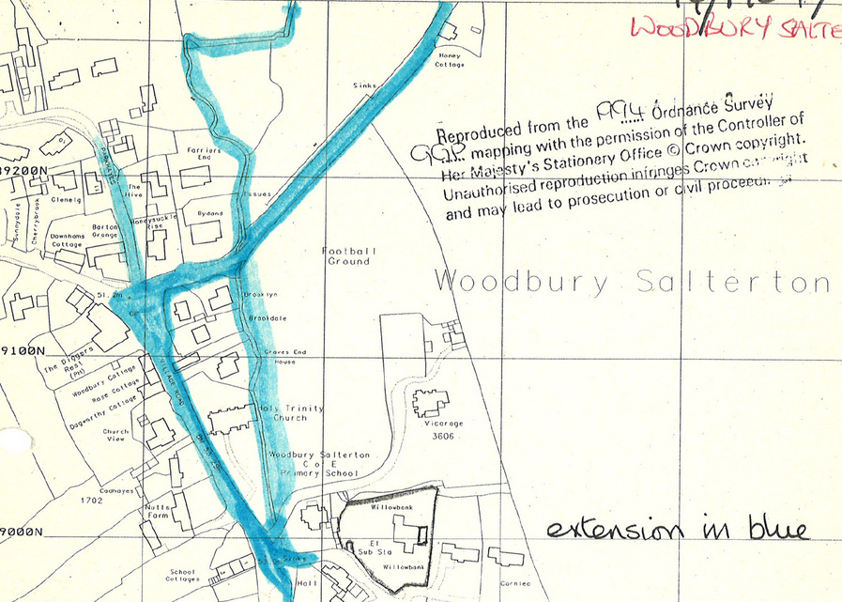
Woodbury Salterton
Resilience Group
Flooding History
Honey Lane
Bridge
Pub
Taken from the
Rivers Authority
records from
the 1993 Floods
Church
School
Culvert

Slide 9
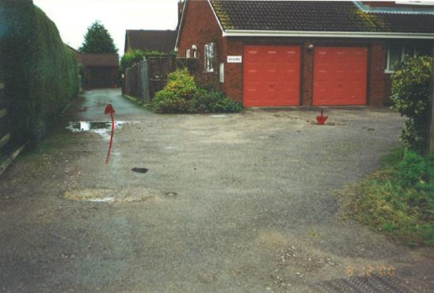
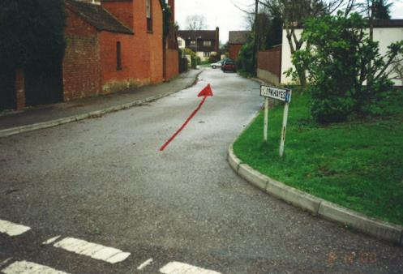
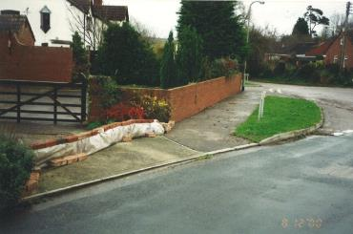
Woodbury Salterton
Resilience Group
Flooding History
After the Floods
in 2000
Showing tidemarks
Taken from the
Environment Agency
records from
the 2000 Floods
DIY Flood Defence

Slide 10
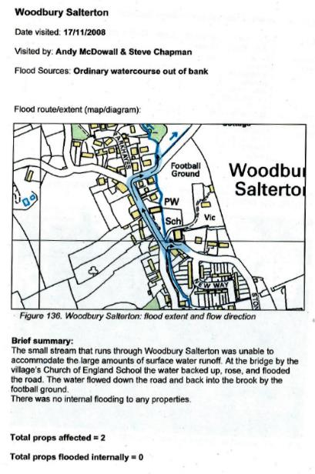
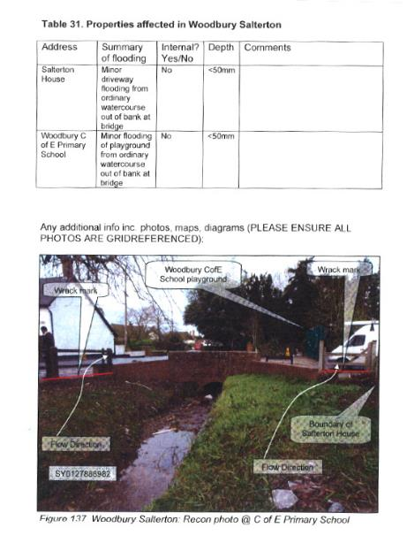
Woodbury Salterton
Resilience Group
Flooding History
Taken from the Environment Agency
records from the 2008 Floods

Slide 11
Flooding History
From a Devon CC
report in 2012
….following this report enquiring if residents were interested in setting up a Flood Watch, but only one resident replied.
…..a flood Watch scheme is required to be organised through the parish council and DCC Highways.
A meeting is scheduled for DCC chief of highways and District/ County Councillors sometime in January…….
Lesson one
No point in asking people in the middle of a heatwave if they want to be involved in flood measures!
Nothing came from this meeting

Slide 12
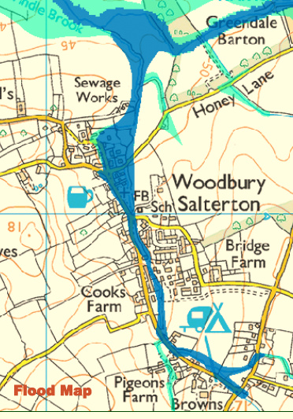
Woodbury Salterton
Resilience Group
1972 Flood
1993 Flood
2000 Flood
2008 Flood
2012 Flood
2015 Flood
In 33 years
6 Flooding incidents!
Every 5 years!!
1 in 100 year incidents?
The Flood Risk Area of Woodbury
Salterton

Slide 13
Woodbury Salterton
Resilience Group
Springs all around us!
Flooding events every
5 years!
Only1 resident interested How were we to get things going?

Slide 14
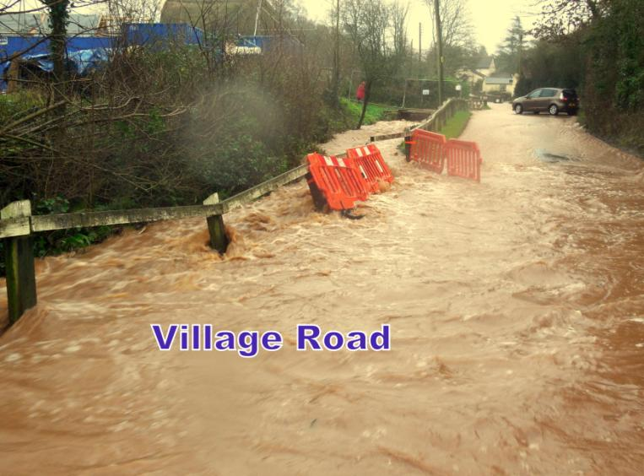
Woodbury Salterton
Resilience Group
Dec 2015 Flood

Slide 15
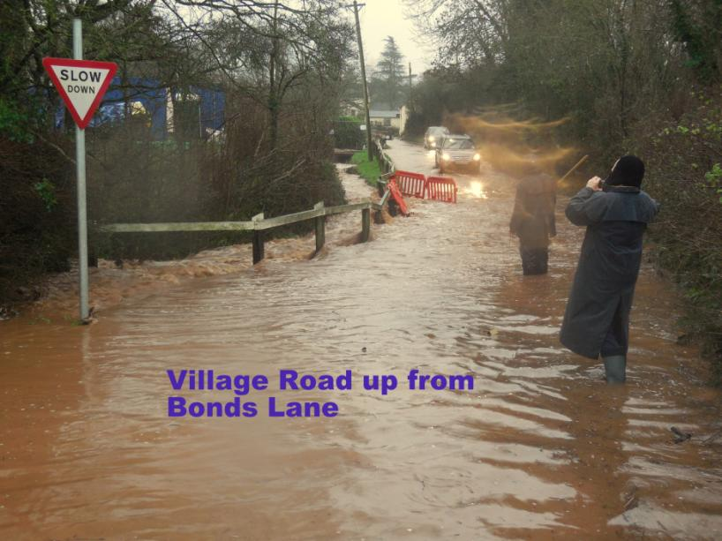
Woodbury Salterton
Resilience Group
Dec 2015 Flood

Slide 16
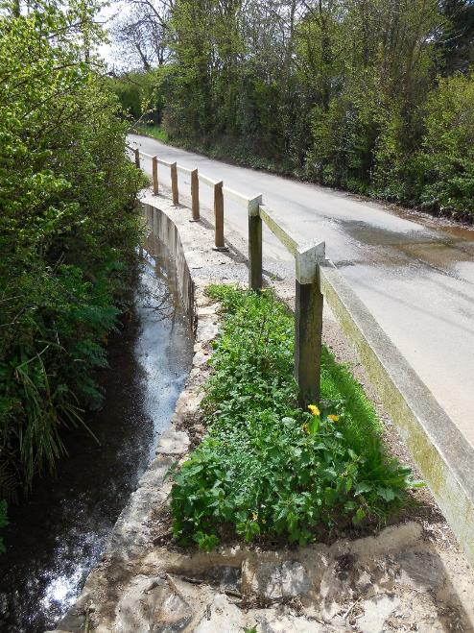
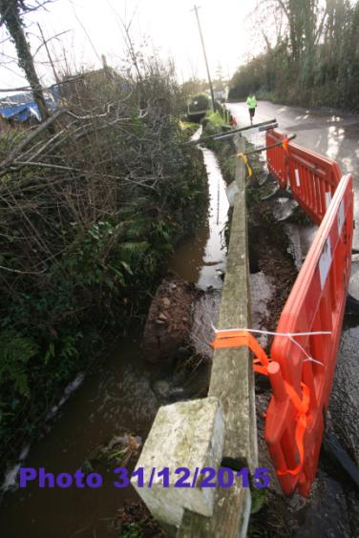
Woodbury Salterton
Resilience Group
Lesson two
The damage after the floods!
The replacement of a few stones turned out to be
a concrete rebuild at ratepayers expense!

Slide 17
Woodbury Salterton
Resilience Group
Dec 2015 Flood

Slide 18
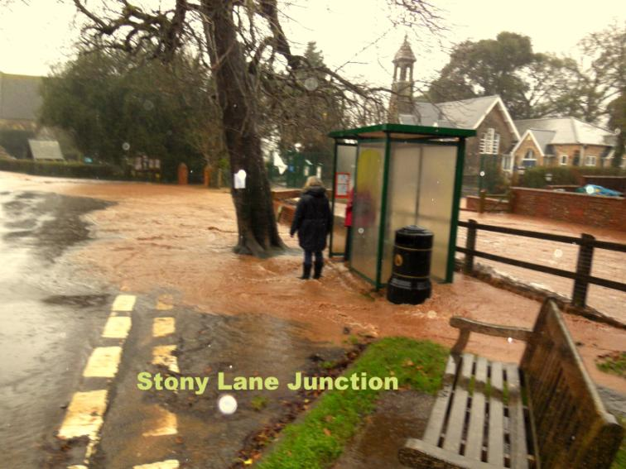
Woodbury Salterton
Resilience Group
Dec 2015 Flood

Slide 19
Woodbury Salterton
Resilience Group
Lesson Three
A stream clearance
Every Autumn
Dec 2015 Flood

Slide 20
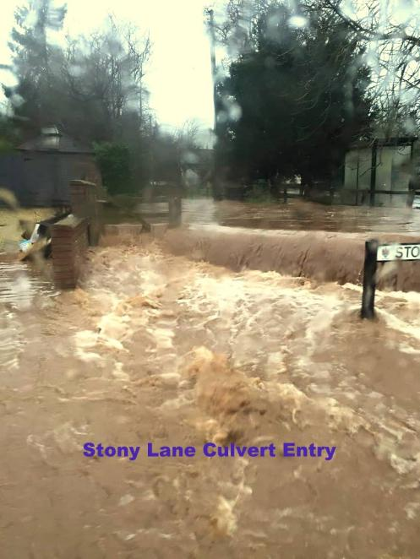
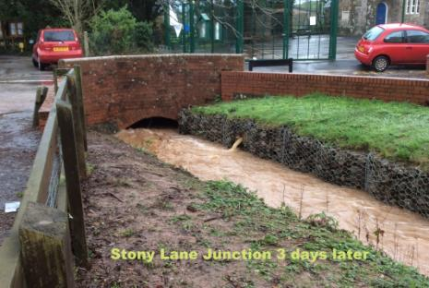
Woodbury Salterton
Resilience Group
Stony Lane Culvert
a few days later
Dec 2015 Flood

Slide 21
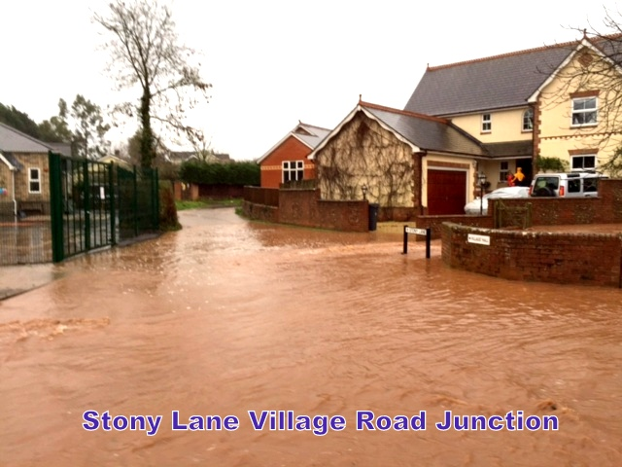
Woodbury Salterton
Resilience Group
Dec 2015 Flood

Slide 22
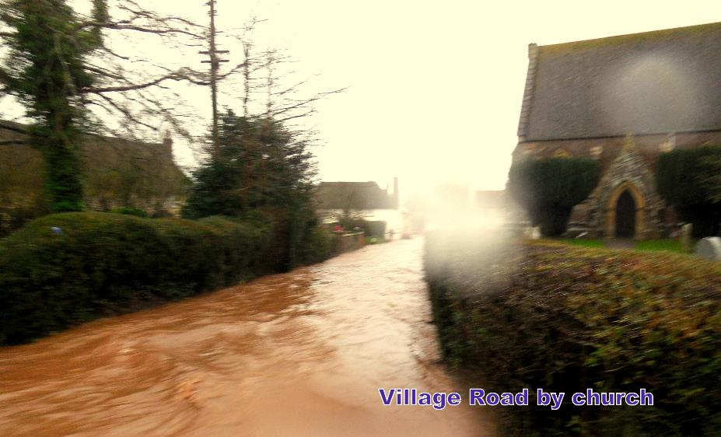
Woodbury Salterton
Resilience Group
Dec 2015 Flood

Slide 23
Woodbury Salterton
Resilience Group
Lesson Four
Allowing cars to go through
Floodwater creates a bow wave
Damages property
Goes over your Wellies!!
Dec 2015 Flood

Slide 24
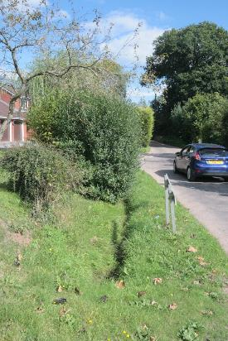
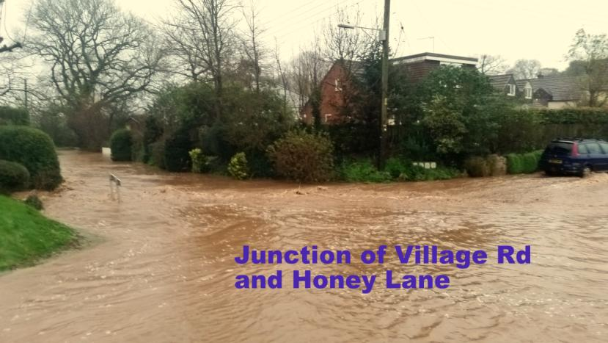
Woodbury Salterton
Resilience Group
Lesson Five
There are deep ditches
at the edge of some
roads!”
Dec 2015 Flood

Slide 25
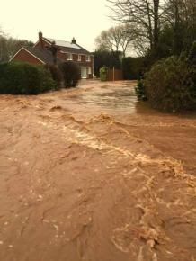
Woodbury Salterton
Resilience Group
The only way the water could go down a
residential
Road
Water Flow from
Honey Lane Bridge
Water Flow from
Higher Road
Honey Lane from the Diggers
Water Flow
down
Village Rd
Dec 2015 Flood

Slide 26
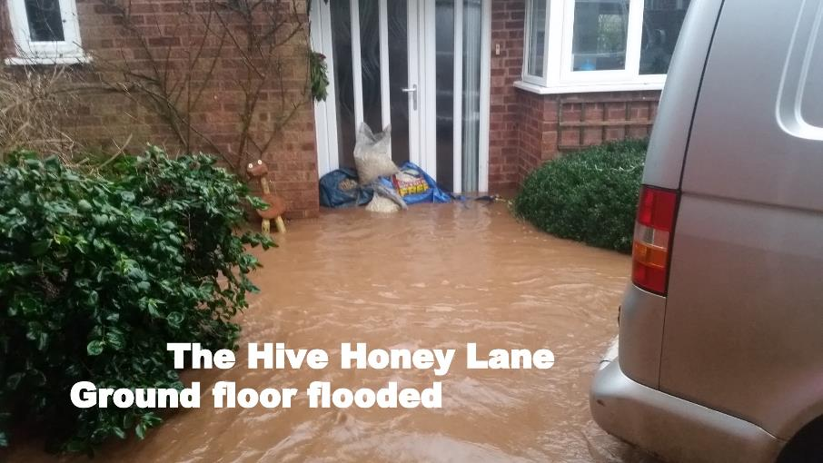
The result of the flooding is the family
Had to move out and lived in temporary accommodation for 6 months while the
ground floor was refurbished
Lesson Six
Our only emergency plan strategy was to provide sandbags!
We now have sand bags & sand bins at strategic points.
Dec 2015 Flood

Slide 27
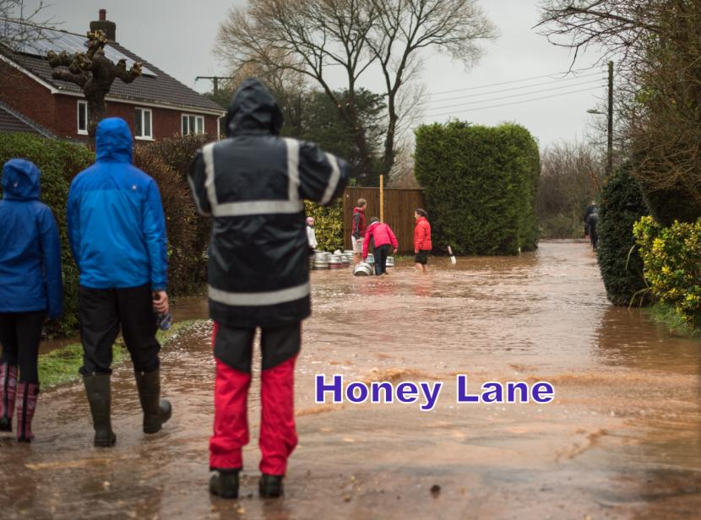
Woodbury Salterton
Resilience Group
Had to resort to using beer barrels from the pub (empty ones!) and then filled with water as we did not have enough sandbags
Dec 2015 Flood

Slide 28
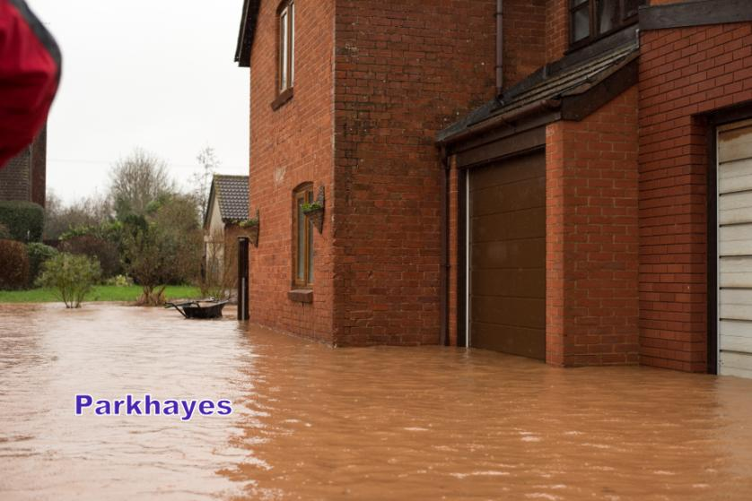
Woodbury Salterton
Resilience Group
Again the residents moved into temporary accommodation for 4 months for ground floors to be repaired
Lesson Seven
Blocked drains probably made this area worse.
We are now aware of all ditches culverts and gullies that DCC Highways manage.
Dec 2015 Flood

Slide 29
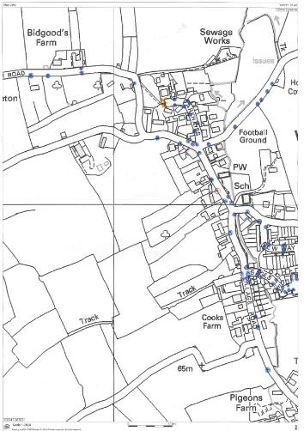
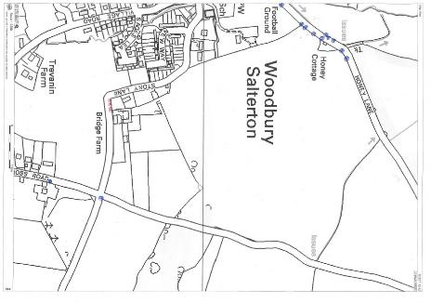
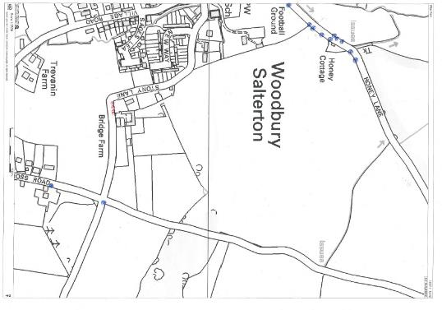
Up to date Highways Gully Map
(work in progress on the gullies
Still requiring engineering!)

Slide 30
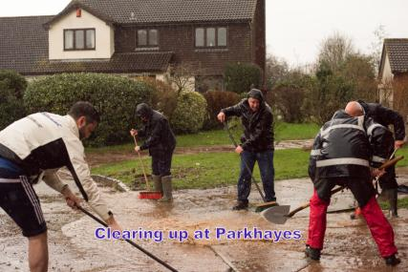
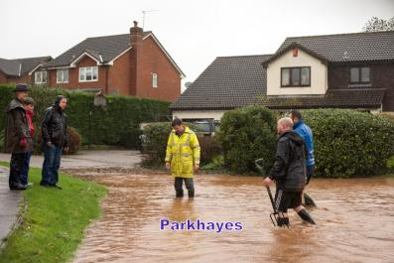
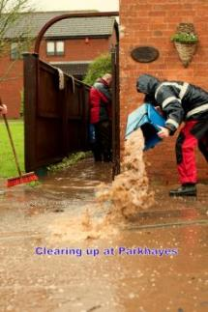
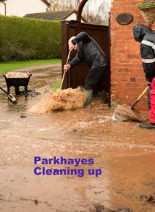
Woodbury Salterton
Resilience Group
Lesson Seven
Plenty of willing volunteers and
basic tools.
But poor communication and no plan!
Dec 2015 Flood

Slide 31
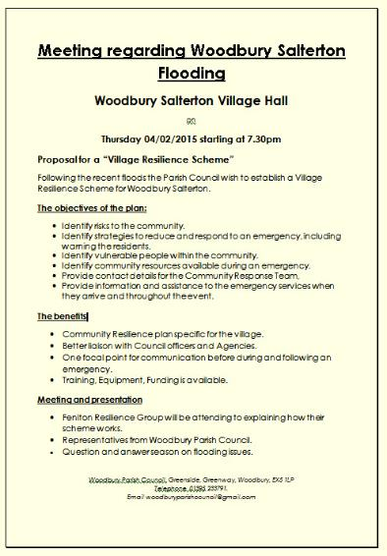
Woodbury Salterton
Resilience Group
Lesson Seven
I didn't have all the answers!
But whilst it was fresh in peoples minds
We organised a village hall meeting!
memory
How do we get sandbags?
Where do we get sand from?
Where is the fire brigade?
Where is our Policeman?
What`s the Council doing?
Do you know if the road is closed?
When's the next bus? I need to go to the New Year Sales!!
This is happening and no one is doing anything!
So what can we do to help ourselves?

Slide 32
Parish Council
A Neighbouring Resilience Group
Devon CC
Flood Group
Leaflet through every letter box to all residents
Village meeting
Environment Agency
Residents Association
County Councillors
Landowners

Slide 33
We set up a steering group to develop the resilience group
We took the name and addresses of all volunteers at the meeting
At the first steering group meeting we decided to
Identify the skills of the volunteers and training needs
Identify the physical flooding problems, and to understand how to overcome them.
Ideas for raising funding and grants.
Draw up an Emergency Plan.
Liaise with DCC Flood team (our stream is not an EA responsibility.)

Slide 34
It wasn’t all Positive!
Obstacles needed to be overcome.
There is no such thing as global warming!
You are not going to stop the flooding, been happening for years.
It`s the farmers growing all that maize!
Why should we have to do it.. We pay our rates for the council to do all this!
You incomers moving here and then you want to change everything!
Its all because all those new houses!
Overcoming the negatives
Parish council didn’t support the idea. It was finally agreed that Woodbury Salterton would start off and then if residents wanted it we would include the villages Exton and Woodbury.
Reluctant to financially support it, all our work and equipment has come from grants!
Overcoming old concepts
Residents doing their own thing, with their properties and gardens being a water “no go” area! Pushing water onto the next property!
Landowners/Farmers cutting hedges and not picking up and damaging ditches.
Landowners disagreeing its their ditch to clear and not willing to allow water to freely flow through.
Legal issues and Riparian Owners Responsibilities
Overcoming Riparian old laws

Slide 35
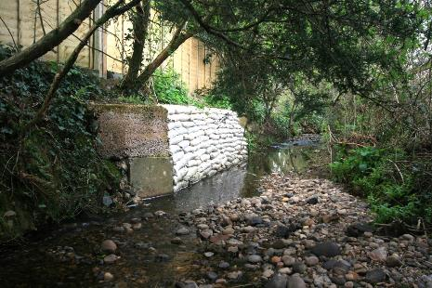
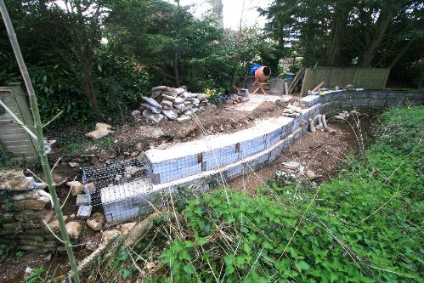
Resident's doing their own thing
This didn't work!
So plan two!

Slide 36
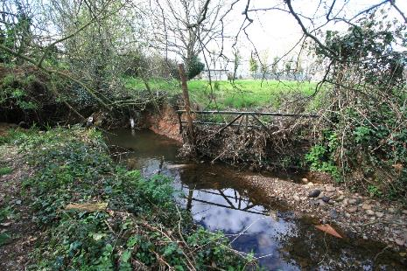
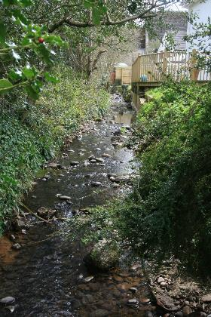
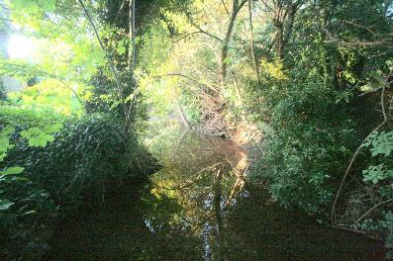
Riparian owners not clearing their stream banks of growth and debris and encroaching the steam bank

Slide 37
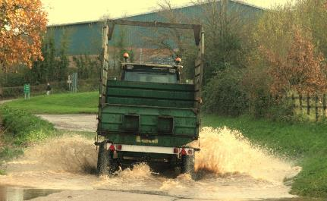
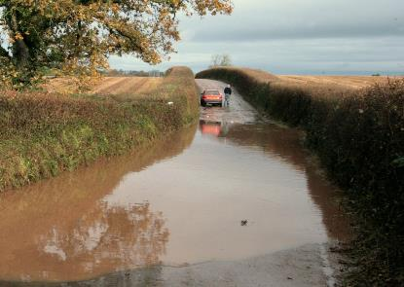
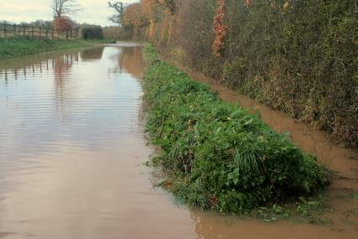
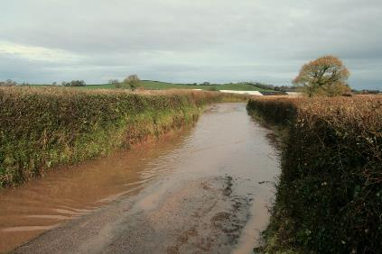
Who cleans out the drainage ditches?
Highways or the Farmer?
Cutting hedges and allowing debris end up in ditches

Slide 38
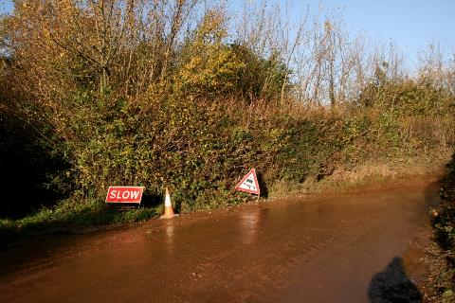
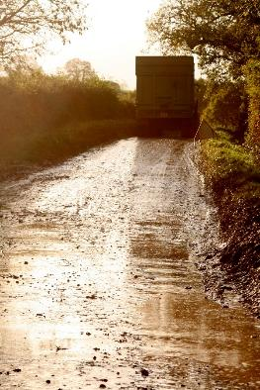
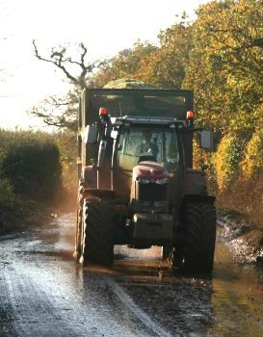
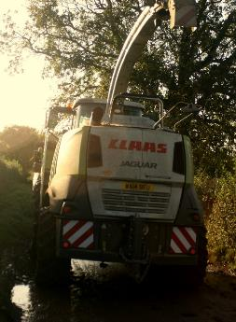
Farming has changed!
Machines are getting bigger!
Nov Dec harvesting of Maize for AD Plants.
Surface water running off compacted fields and mud filled road drains

Slide 39
We have lowered the stream bed from the School Culvert through the churchyard

Slide 40
Taking this section out to open up the second culvert
Widened and straightened the stream before the bridge on Honey Lane

Slide 41
Cut the bank away below Honey Bridge,

Slide 42
One resident built substantial gabions on the edge of his property, whilst the other bank was restricted by a large tree. The stump is too big to shift (no access for large machinery) so we dug a new channel around it!

Slide 43
Re-opened an old relief channel or boundary ditch to allow flood water to flow during a storm event
The work we have carried out is to encourage the speed of flow of water through the village and

Slide 44
It’s a great community event!
We have an annual stream clearance, which we invite all “riparian” owners to join in and we ask permission to access the stream on “their land”

Slide 45
This weekend we managed to put up the storage shed
The Parish Council didn’t want
it in a central location and took a few months to agree!
Needed to be in a central position close to the flooding areas but not in the flood zone

Slide 46
Raised £6000 Plus.
We organise an annual stream clearance. (community event)
Built a storage shed
Purchased Sand Bins
Dug Ditches and improved the stream flow
Worked with DCC Highways on Gullies and drainage.
With the help of Highways worked with a landowner to clear ditches
The Environment Agency fitted a rain Gauge for the Parish (will be able to give us an early warning)
The Environment Agency carried out some work at Exton
Working with other groups
Requested a grant for a Defribulator (awaiting outcome)
Emergency Plan almost complete

Slide 47
Woodbury Salterton
Resilience Group
We started off with a basic business plan
Plan your plan!
1. Summary (write this when you have done the following list)
2. Details. Name, of group, if through the Parish Council or a separate entity.
3. Strategy. Aim, Objective, find a model group to follow.
4. Team. Who and how are you going to find a team?
5. How to setup. Meeting, Email list, Facebook, Website.
6. Financial Plans. Grants, Bank Account, Vat Registered?

