Slide 1
Devon Community Resilience Forum
Becoming Resilient Programme
9th November 2016
How to assess risk
Neil Hamlyn
Local Resilience Forum Manager for
Devon, Cornwall & Isles of Scilly

Slide 2
Aim
Provide an overview of how to approach risk assessments for Community Emergency Planning.
Masters of risk?
Notes:
We assess local risks but base it on the national assessments
NRA – confidential/secret produced by Government scientists for all depts, police forces and responders
Risk Lead Assessor from appropriate organisation e.g.
Maritime = MCA
Flooding = EA
Sever space weather = Met Office

Slide 3
“Planning is an unnatural process – it is much more fun to do something else. And the nicest thing about not planning is that failure comes as a complete surprise rather than being preceded by a period of worry and depression”
Sir Harvey Jones
(former Head of ICI)
Notes:
Who likes planning??
We are in the business of worrying about the worst that could happen to us all!!

Slide 4
UK Resilience
“The Government's aim is to reduce the risk from emergencies so that people can go about their business freely and with confidence.”

Slide 5
How the LRF
assess risk
Notes:
Explain how the risk matix works

Slide 6
Local Resilience Forum Duties
LRFs must have a planned and organised approach for its members to:
  Assess the risk of emergencies in the LRF
  Plan for emergencies
  Plan for business continuity management
  Publish information about risk assessments and plans
  Have arrangements to warn and inform the public
  Share information with other responders
  Co-operate with other responders
Assess the risk of emergencies in the LRF

Slide 7
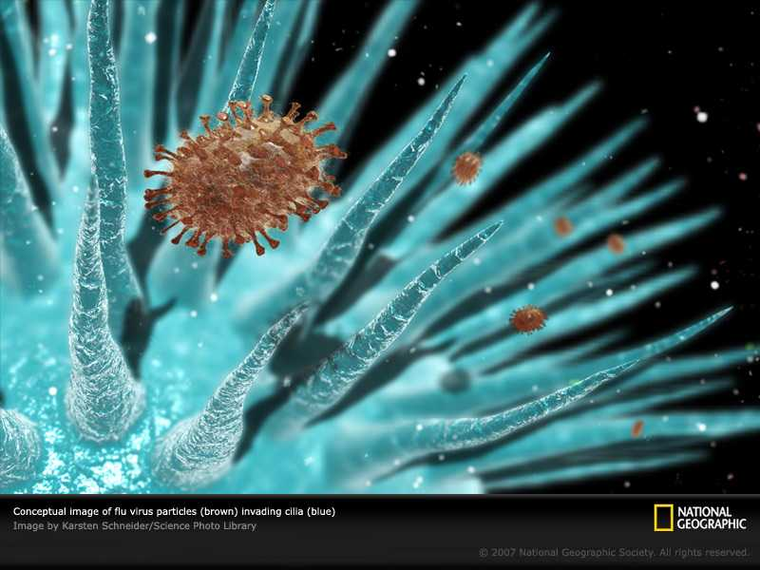
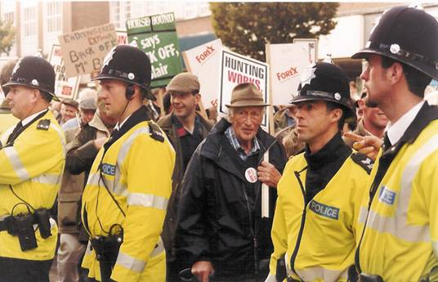
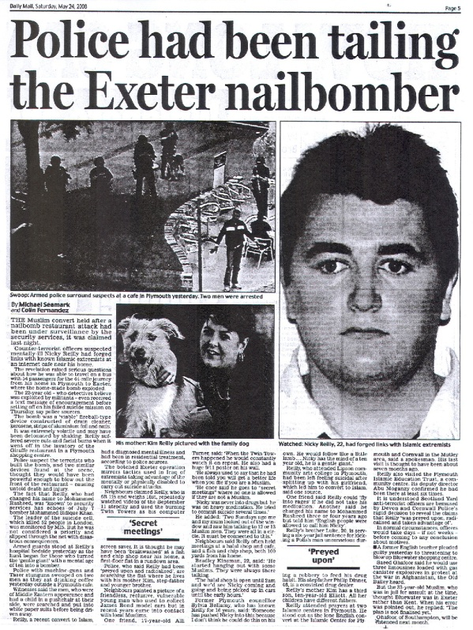
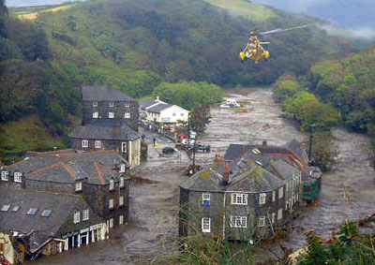
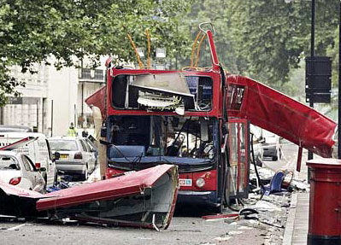
Risk Assessment Groupings
Risk assessment carried out by LRFs
Focus on local area, based on national risks
Split into two groupings...
HAZARDS
Flooding, infectious disease, strikes...
THREATS
Terrorism, malicious attacks
Notes:
Risk Assessment
‘A systematic process that produces a range of measures that contribute to the wellbeing of communities and the environment’
Assessment carried out by Local Resilience Forum
Local determination, but UK standardised i.e. consistent approach means its easier to compare and share risk information at all levels
TWO DISTINCT AREAS…we focus on hazards
Hazards
Severe weather (flooding), explosion, pollution etc.
Threats
Malicious attacks

Slide 8
ID | Hazard | Lead | CM% |  | ID | Hazard | Lead | CM%
HH002 | Influenza-Type Disease (Pandemic) | PHE | 84%
SW005 | Flooding: Major coastal/tidal | EA | 86%
SW006 | Flooding: Major fluvial | EA | 85%
SW007 | Localised fluvial flooding (flash flooding) | EA | 81%
AH002 | Zoonotic notifiable animal diseases | APHA | 82%
HH001 | Epidemic Influenza | PHE | 76%
IA017 | Major Pollution of Controlled Waters | EA | 75%
IA022 | Major Air Quality Incident | EA | 82%
IT006 | Failure of local electricity network due to severe weather and technical failure | CC | 82%
SW002 | Prolonged Low Temp, Heavy Snow and/or Ice | Torbay Council | 80%
SW004 | Heatwave | PHE | 35%
SW012 | Severe effusive volcanic eruption | CC | 33%
VERY
H I G H
4 x VERY HIGH
8 x HIGH
Last update: 04 Oct 16
Notes:
Here are our VERY HIGH and HIGH risks…
Come back to this later.

Slide 9
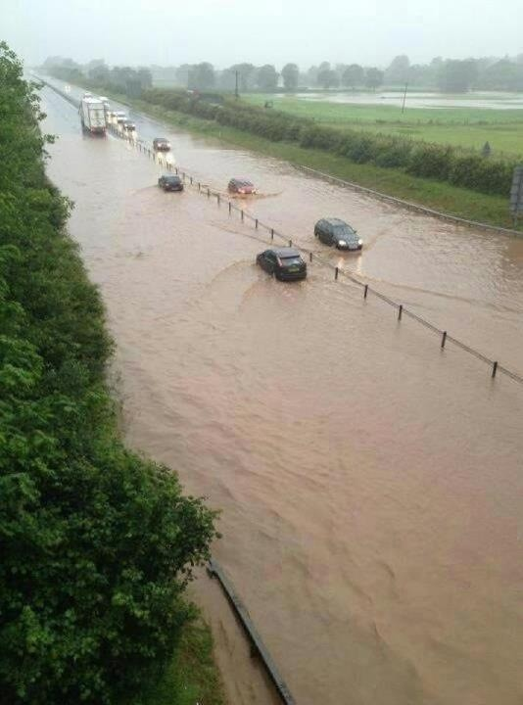
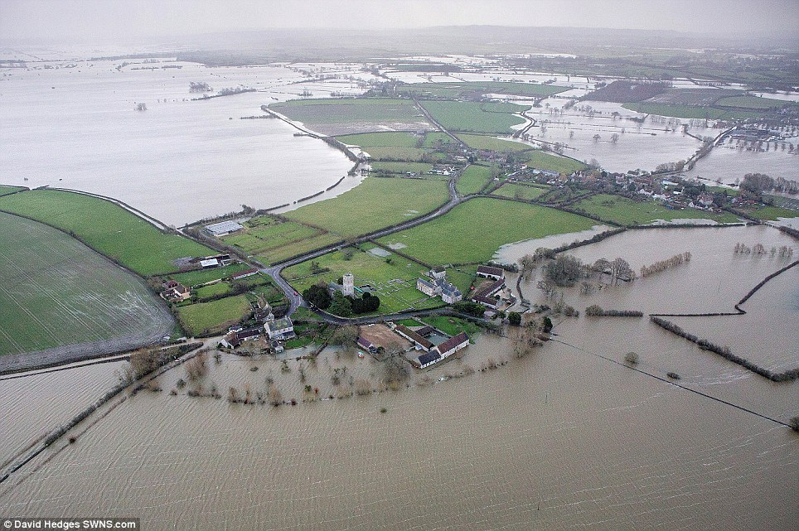
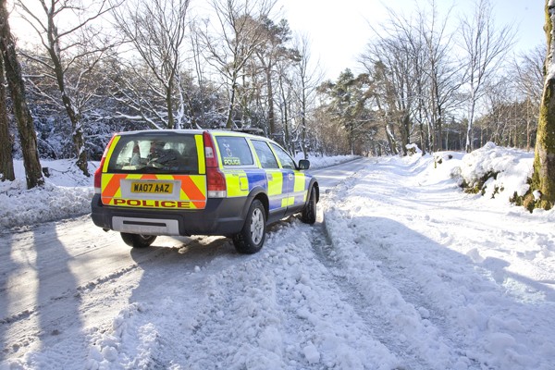
Notes:
Hazard:
Stoke Canon (2012),
Flooding 2010, 2011,2012,
Napoli, Branscombe 2007,
Snow & ice 2010, 2011,
Boscastle (Aug 2004)
Explain consequence management: risk has occurred our job is to reduce the impact on our community

Slide 10
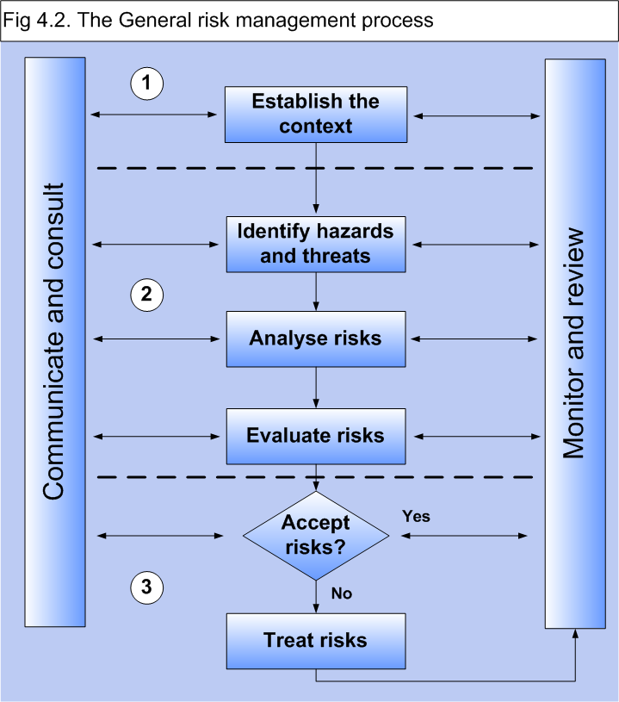
Risk assessment – process
1. Local knowledge
2. Identify your risks
3. Evaluate your risks
4. Decide: What are you going to do about them?
Notes:
Local knowledge:
how many people live here;
streams that may get blocked;
narrow access to community hall

Slide 11
The Process
Step 1 – Establish context, use local knowledge
Step 2 – Identify potential risks
Step 3 – Evaluate and classify each risk
Step 4 – Decide on mitigation for each risk and produce your risk assessment

Slide 12
Step 1
Establish context, use local knowledge
Notes:
Explain how the risk matix works

Slide 13
Step 1
Establish context, use local knowledge
Population
Waterways
Access/Egress
Safe locations
Schools
Communications

Slide 14
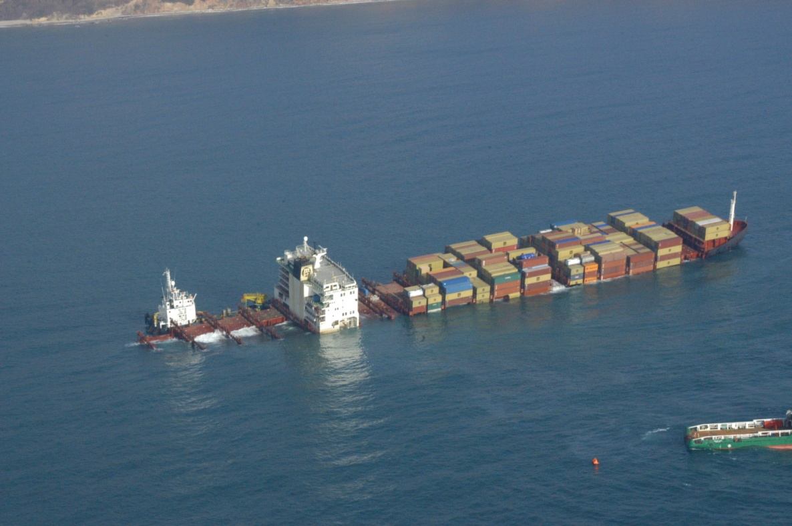
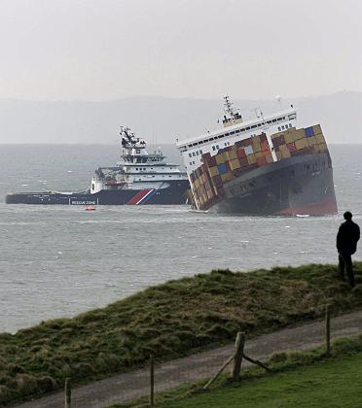
MCS Napoli
2007 Branscombe, Devon
Notes:
In January 2007 the MCS Napoli, a huge ship loaded with nearly 2400 containers and 3500 tonnes of fuel, left Antwerp bound for South Africa. Battered by fierce gales in the English Channel, she started to break up and was run aground on Branscombe beach.
Oiled sea-birds washed up on the pebbles; over a hundred containers slid off the listing ship. Some sank onto the sea-bed, others were thrown onto the beach. Some were torn open by the sea, others by treasure-seekers, both local and, as the media spread the news abroad, from far away.
A massive clean-up got under way; the ship was eventually blown in half. Half of it was towed to Belfast, and two years later, in the summer of 2009 the last pieces were lifted from the sea-bed.
Napoli became the second most expensive salvage operation in the world

Slide 15
Step 2
Identify potential risks
Notes:
Explain how the risk matix works

Slide 16
Step 2
Identify potential risks
Industrial accidents
Transport accidents
Flooding
Terrorism
Human illness
Severe weather
Tsunami wave
Animal disease
Space weather

Slide 17
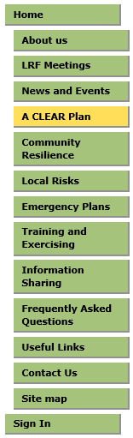
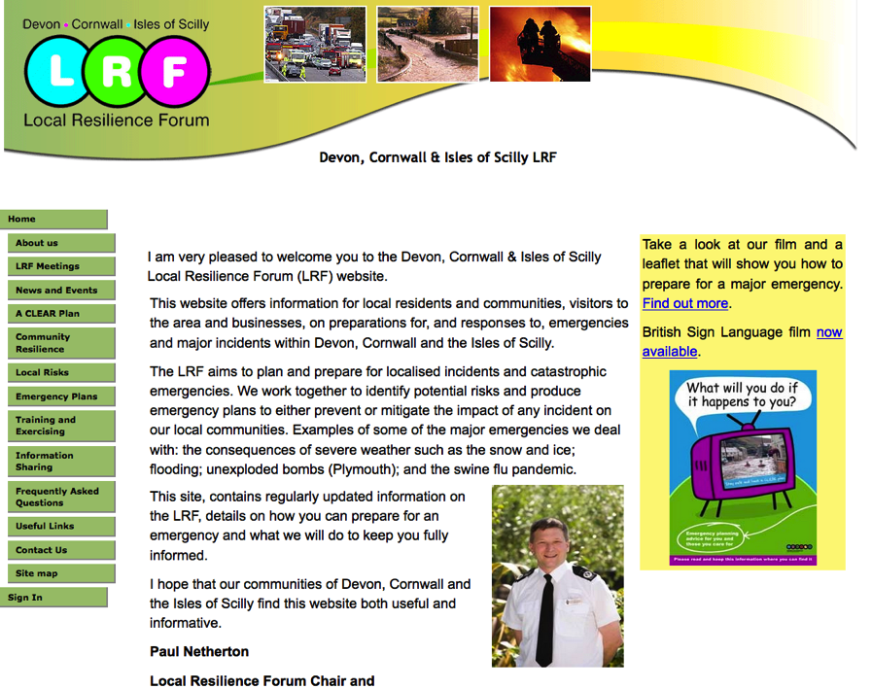
Step 2
Identify potential risks
Start with the Local Resilience Forum Community Risk Register
www.dcisprepared.org.uk

Slide 18
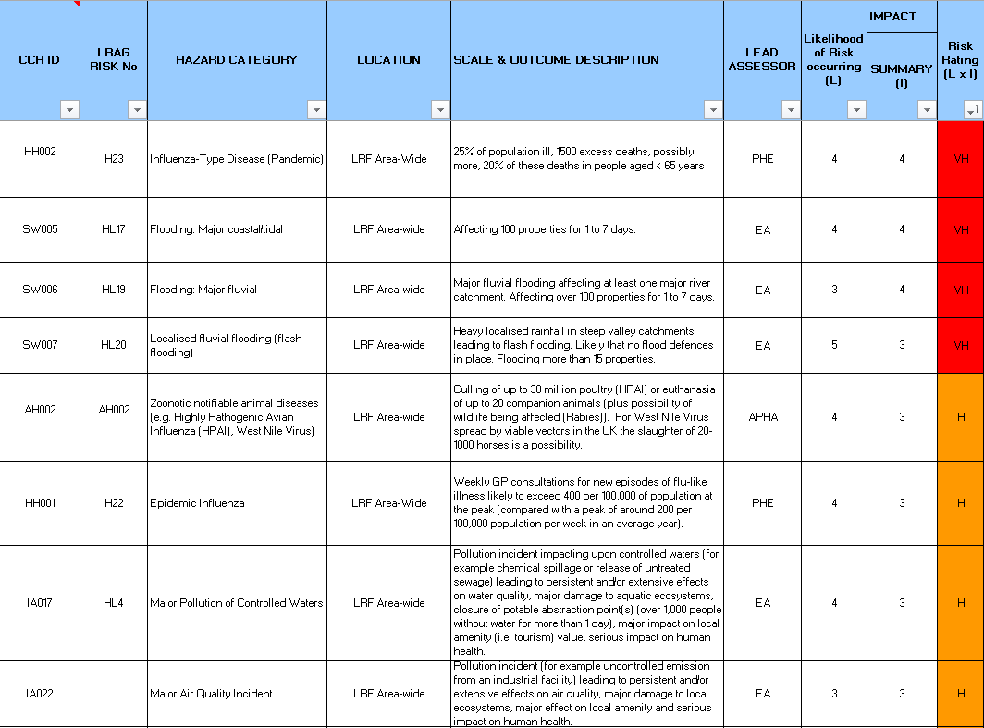
Step 2
Identify potential risks
Notes:
LRF have identified 70 hazardous risks and they are all in the CRR
Threats are not listed

Slide 19
Step 2
Identify potential risks
Other aspects to consider when assessing the impact of incidents on your local area could include:
Social risks
Environmental risks
Infrastructure risks
Technical risks
Notes:
Deprivation issues
Local factories – chemicals
Old collapsed buildings

Slide 20
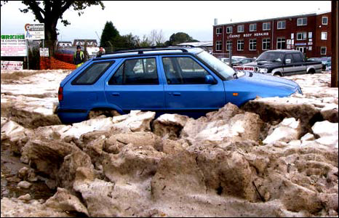
Can we identify every risk?
Hailstorm: 2008 Ottery St Mary
Notes:
Ottery St Mary – hailstorm in October 2008
Such was the volume of hail reaching the town that the banks of hail were as deep as 1.2m in places and actually resembled ice floes moving the town. Such was the depth of the hail that some media sources talked of snowdrifts. Gradually the hail melted and caused flooding.
The floods reached 1.5m in places. Numerous calls were made to the emergency services. By 0500 Ottery was cut off and around 100 people had to be evacuated, some even had to be airlifted to safety.

Slide 21
Step 3
Evaluate and classify the risks
Notes:
Explain how the risk matix works

Slide 22
Step 3
Evaluate and classify the risks
LIKELIHOOD
IMPACT
VERY HIGH
HIGH
MEDIUM
LOW
Notes:
Explain how the risk matix works

Slide 23
Step 3
Assess the likelihood of the risk happening
Evaluate and classify the risks
1 : 2
LRF look at the chance of it happening in the next 5 years…
1 : 20
As a community you need to do what feels right
1 : 200
1 : 2,000
1 : 20,000
 | Low | Medium Low | Medium | Medium High | High
1
2
3
4
5
LIKELIHOOD
Notes:
LIKELIHOOD
In our example for low temperatures/snow/ice we assess as a 4 or a MEDIUM/HIGH chance of this happening n next 5 years.

Slide 24
Step 3
Assess the impact of the risk
Evaluate and classify the risks
Catastrophic
Significant
Moderate
Minor
Limited
Take into account….
5
Fatalities
Casualties
4
IMPACT
3
£
Economic
Social disruption
2
1
Psychological
Environment
Notes:
Social disruption underpinning elements: transport; food & water; fuel/gas; electricity; finance & communications; education; access to healthcare; evacuation and shelter

Slide 25
Step 3
Evaluate and classify the risks
The Risk Matrix…
Catastrophic
Significant
Moderate
Minor
Limited
 | Low | Medium Low | Medium | Medium High | High
IMPACT
HIGH
3
4
LIKELIHOOD
Notes:
IMPACT
Explain tables:
Show limited and minor first…then catastrophic
Level is the impact score
Explain what categories mean (see table 4 on A3 sheet)

Slide 26
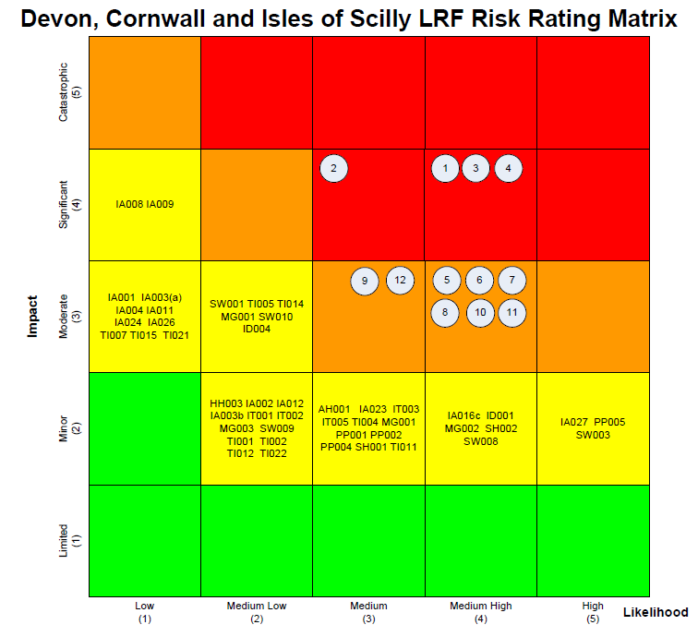
Step 3
Evaluate and classify the risks
Plot all your risks on one matrix table
Notes:
Explain grading table

Slide 27
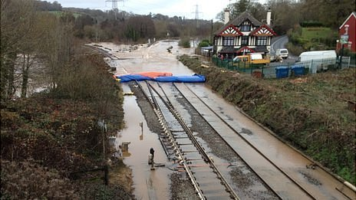
Main rail route flooded at Exeter, no trains for 11 days
2012 Cowley Bridge, Exeter
Notes:
COWLEY BRIDGE
Main rail route flooded at Exeter, no trains for two weeks – November, December 2012
LRF letter to Network Rail made national news and was debated in Parliament
BBC quote
“[LRF] is a powerful and wide-ranging group, comprised of the police, fire and ambulance services, the NHS, councils, the Highways and Environment Agencies and others. It is little known because it usually operates diplomatically and behind closed doors.”

Slide 28
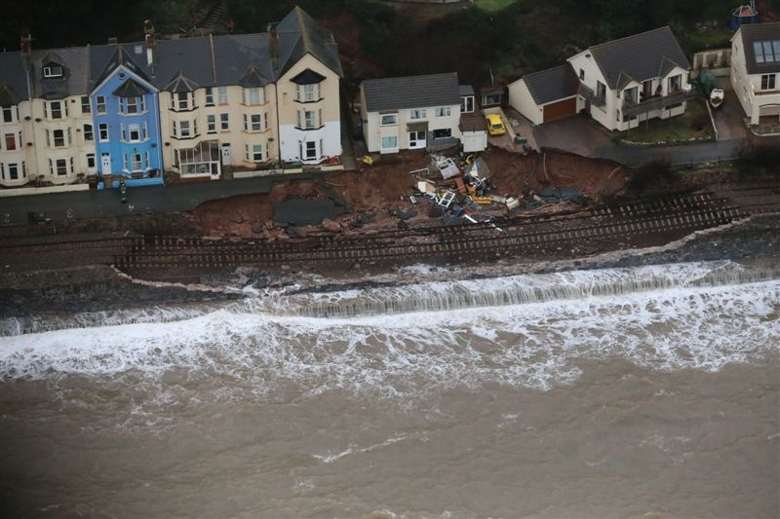
Railway collapse: 6 weeks no train connection
Feb 2014 Dawlish, Devon
Notes:
DAWLISH

Slide 29
Step 4
Decide on mitigation
Notes:
Explain how the risk matix works

Slide 30
Step 4
Decide on mitigation
All your local risks in one matrix table/document
Prioritised by rating:
Focus on the highest risks, then we can consider…
…mitigation of the risk:
do we tolerate it? Do nothing
do we treat it? Put in place a plan/training/testing
do we transfer it? Give it to somebody else to deal with/insurance
do we terminate it? Agree to remove as no longer a risk to us
VERY HIGH
HIGH
MEDIUM
LOW

Slide 31
Produce your risk assessment…
Step 4
Decide on mitigation
RISKS | IMPACT ON COMMUNITY | MITIGATION: what can the community emergency group do to prepare?
Village river can flood | Flooding on streets | Encourage residents to improve home defences
 | Properties flooded | Work with local emergency responders: assist with flood warnings; identify evacuation and rest centres
 | Damage to property | Find out what flood defences exist or are planned in the area
Next risk….

Slide 32
Summary
Step 1 – Establish context, use local knowledge
Step 2 – Identify potential risks
Step 3 – Evaluate and classify each risk
Step 4 – Decide on mitigation for each risk and produce your risk assessment

Slide 33
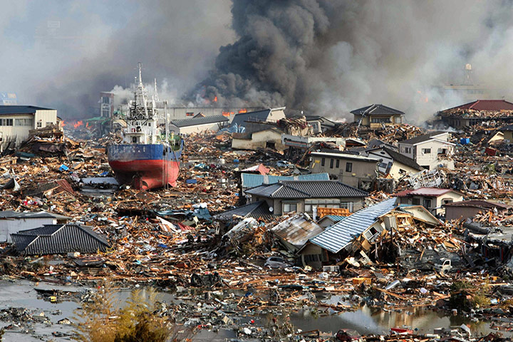
Notes:
Japanese Major Tsunami March 2011
3 to 6 metres high
Reached height of 30 metres in places (Ryori Bay)
Reached coats of North and South America

Slide 34
UK TSUNAMI?
Notes:
This Tsunami occurred in 1755 – Lisbon, Portugal

Slide 35
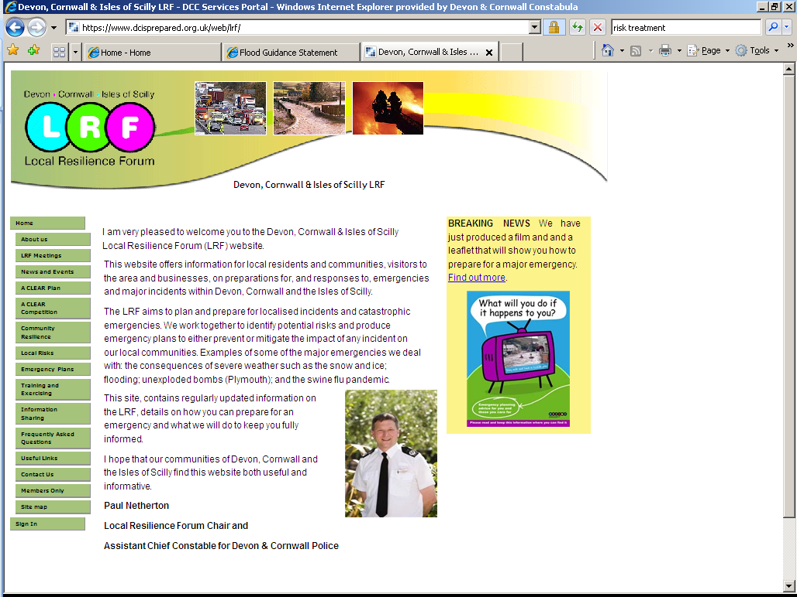

Any Questions?
Neil Hamlyn
LRF Manager
www.dcisprepared.org.uk
@neilhamlyn
Notes:
WEBSITE

